Slide 1
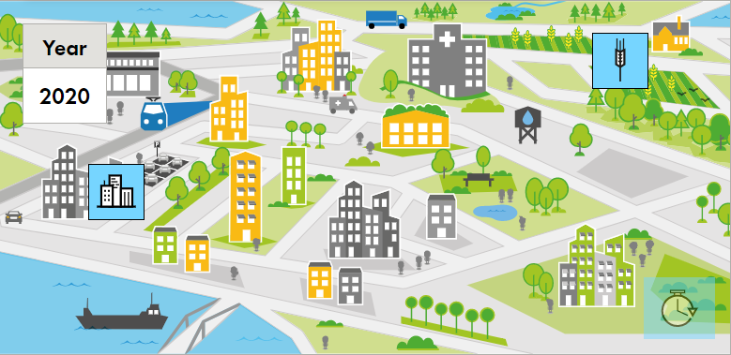
The Climate Adaptation Game

Slide 2
Adaptation to climate change
Introduction to climate change adaptation - preparation for playing

Slide 3
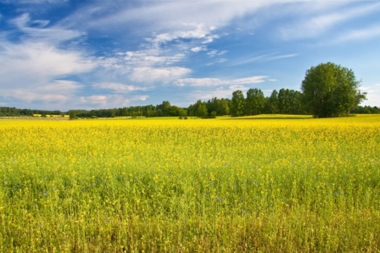
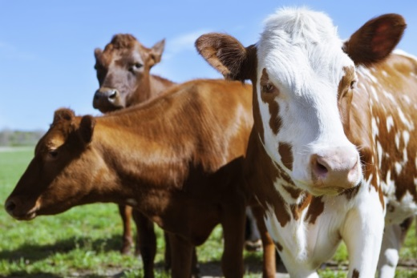
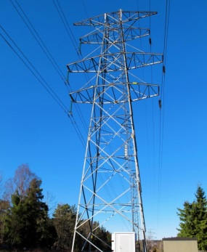
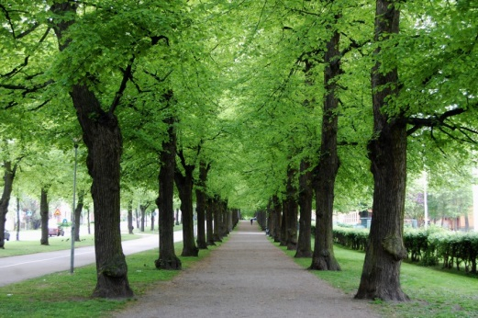
Climate change adaptation
Climate change adaptation strives to strengthen the society to challenges coming from climate change.

Slide 4
Climate change adaptation
Difference between weather and climate
Difference between mitigation and adaptation
Useful expressions:
Extreme weather – drought, cloud burst, heat wave
Effects – food and water scarcity, flooding, health issues, power outs

Slide 5
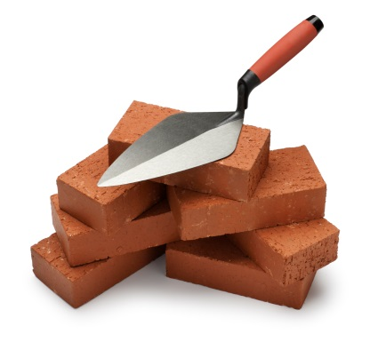
Types of adaptation measures
TYPE OF MEASURE | EXAMPLE
ANALYZING | Assembly and analysis of data or gathering of information.
STEERING/ ORGANIZATIONAL | Change of laws or new types of co-operation
INFORMATIVE | Education or developing communication strategies
TECHNICAL/ ECOSYSTEM BASED | Protective barriers or planting of trees

Slide 6
A game about adaptation?
Common ground for discussions about climate change adaptation
Easy and quick way of getting an idea of the complex challenges of climate change adaptation
Raise awareness and curiosity about climate change and adaptation

Slide 7
Serious Games
A main purpose other than entertainment (or competing)
Method for shedding light on complex contexts
Starting point for discussion
Used as pedagogic tool for more than 200 years. Utilized within the military and environmental education.

Slide 8
An opportunity to visualize (simplified) climate scenarios

Slide 9
The game
The phases of the game (x4)
Read the challenges
Think, and discuss within and in between groups
Take a decision
See the result

Slide 10
Role play in Weatherton
Seven challenges
Protect the hospital from flooding
Save the drinking water
Densify the city
Create a new housing area
Adapt existing buildings to climate change
Protect the agriculture from drought
Create a new industrial area
Take into account the insecurities regarding extreme weather, risks, economics and sustainability
See the effects in four time steps from 2020 to 2100

Slide 11
Role play in Weatherton
Seven interest groups:
Business and Trade Association
Agricultural Society
Union of Tenants
Senior Organization
Property Owners' Association
Society for Nature Conservation
Citizen Association - Don’t touch my lifestyle!

Slide 12
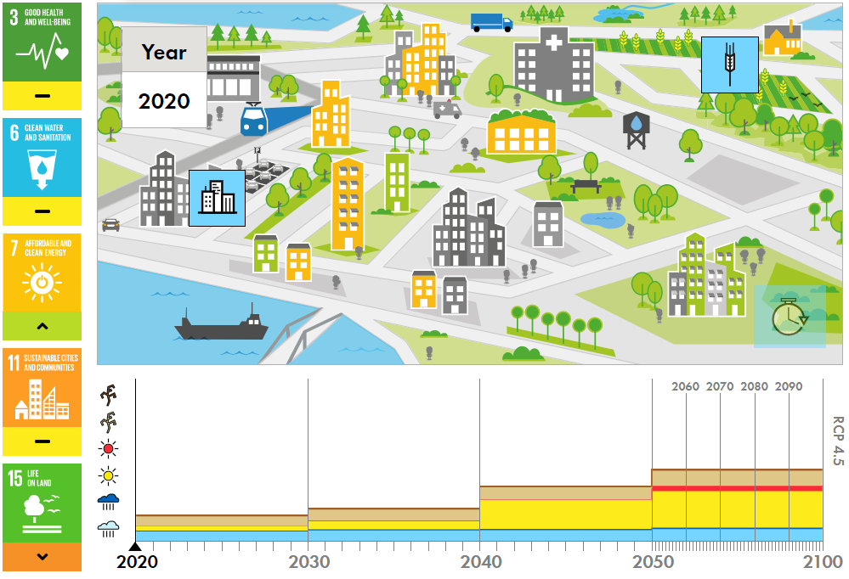
Time to play!

Slide 13
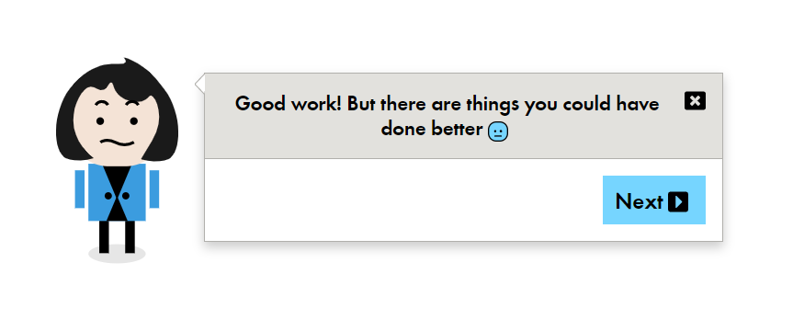
Reflections

Slide 14
Discussion
The most valuable outcome of Serious gaming is the discussion it creates.
What got your attention during the game?
How does the game highlight the need for cities to adapt to climate change?
Anything missing in the game?
What challenges do we have in our own organization?
What priorities do we make?

Slide 15
Not included in the game?
Examples of subjects not included:
5 of 17 development goals are included
Impact of events in other cities or countries
Gender equality
Segregation
Law and order
…

Slide 16
More interested in adaptation?
Web pages for deeper understanding:
Swedish website for climate chane adaptation
Swedish examples of adaptation measures
The sustainable development goals

Slide 17
Thanks for playing!

