Slide 1
Metodkonferens, 3 maj 2022
Semjon Schimanke and the C3S_322_Lot1 team

Slide 2
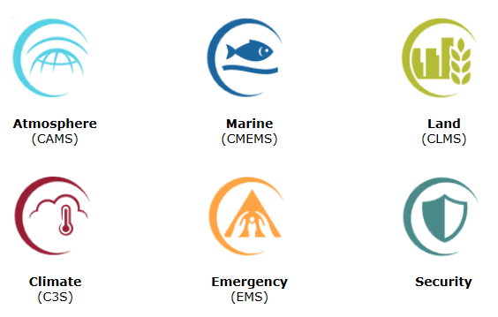
Copernicus/C3S
Copernicus is the European Union’s earth observation program (http://www.copernicus.eu/)
Copernicus Climate Change Services (C3S) (http://climate.copernicus.eu/)

Slide 3

Time line of service and system details
2017
2018
2019
2020
2021
UERRA-HARMONIE operational
(11km resolution)
CERRA-EDA
(10 members, 11km)
MESCAN-SURFEX operational (5.5km resolution)
CERRA
(5.5km resolution)
Development of the new system
CERRA-Land
(5.5km resolution)
11 km (565x565 grid points), 65 levels
Surface/soil analysis 5.5 km (MESCAN-SURFEX)
1961 – July 2019
CERRA: 1069x1069 grid points, 106 levels
CERRA-Land: precipitation analysis and land surface model integration
Starts in the September 1984
Notes:
UERRA=Uncertainties in Ensembles of Regional ReAnalysis, a preoperational FP7 project, www.eurra.eu
EDA=Ensemble data assimilation
Note that the surface downscaling in the UERRA system is decoupled (offline) from the 3D product. In contrast to that the surface analysis will be included into the new system.

Slide 4
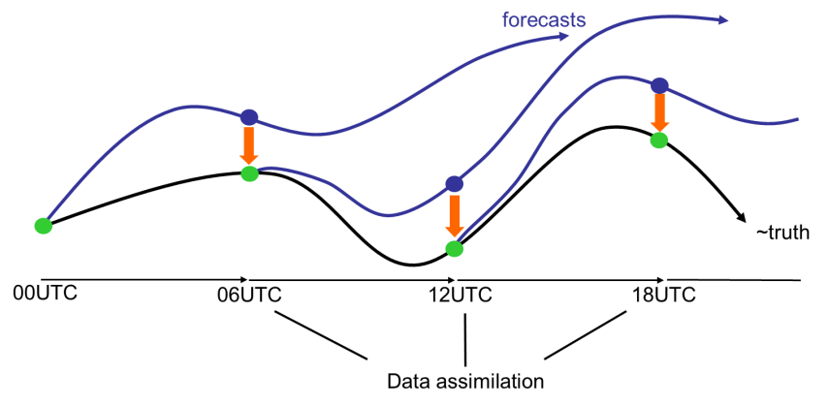
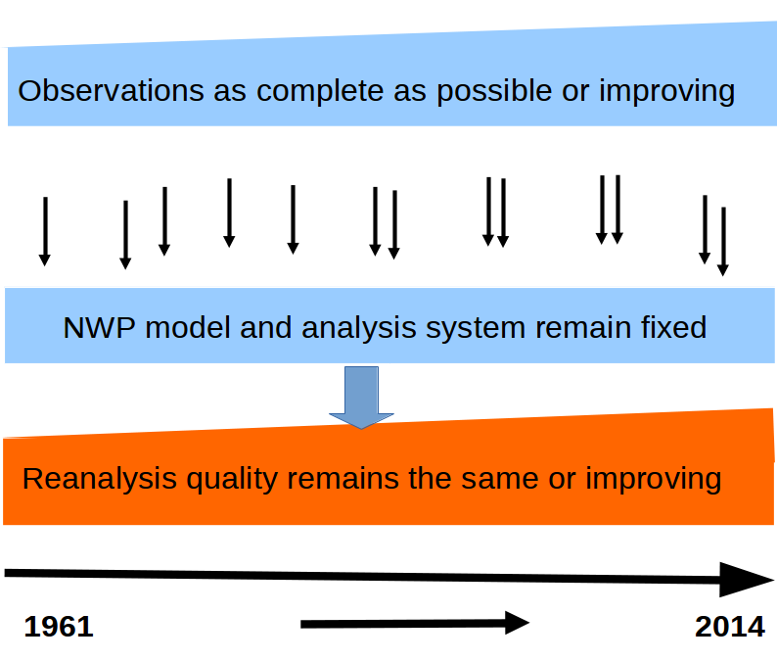
What is a reanalysis?
Usage of a fixed system for the entire period
Usage of as many observations as possible including quality control
That’s called a reanalysis.
Advantages:
No gaps in room or time
Complete parameter set
Homogeneous in time
now

Slide 5
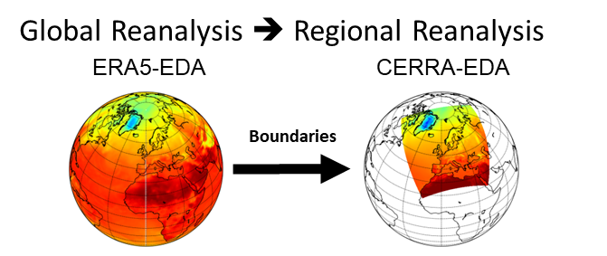
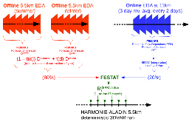
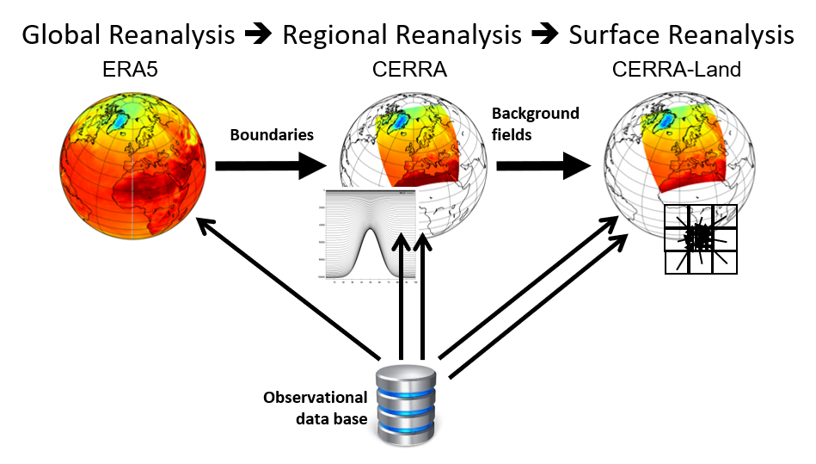
The systems – an overview
CERRA system
  HARMONIE cycle 40h1.2, ALADIN physics (partly back phased from cy42)
  3D-VAR for upper air observations and OI at the surface
  Estimation of background errors from CERRA-EDA
  ERA5 as lateral boundary conditions
  Assimilation of conventional observations, satellite radiances (MSU, AMSU-A+B, and IASI), GB-GNSS, RO-GNSS, AMV and scatterometer winds
  8 cycles per day, forecast lengths 6h and 30h
  5.5km horizontal resolution (1069x1069) and 106 vertical levels
CERRA-EDA (same as CERRA beside)
  10 members
  11km horizontal resolution
  4 cycles per day with 6 hourly forecasts
CERRA-Land
  Daily precipitation analysis
  Land surface model – SURFEX 8.1
  5.5km resolution
10x
Notes:
CERRA-EDA and especially the computation of the B-matrix will be presented by Adam tomorrow!

Slide 6
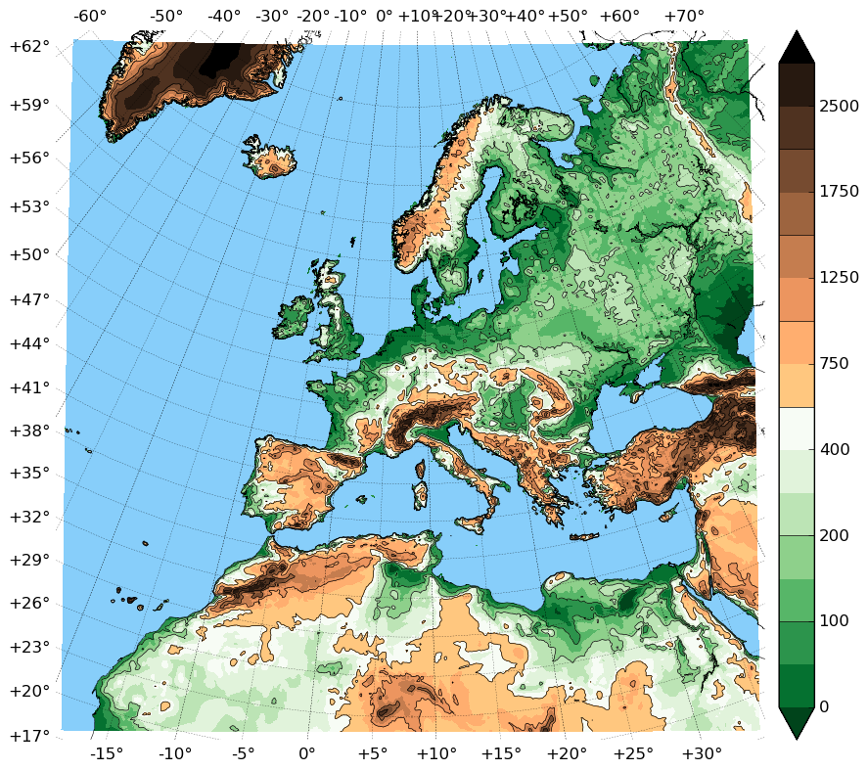
Available data
Modell domain covers entire Europe
Periods
1961 – July 2019 (UERRA-HARMONIE)
Sept. 1984 – June 2021 (CERRA) will be available soon.
36 surface parameters,
11 parameters on pressure levels,
10 parameters on height levels,
4 parameters on model levels
3 parameters on soil levels
Additional output from the land surface model (surface and soil)
Complete UERRA-HARMONIE available in the CDS:
https://cds.climate.copernicus.eu/cdsapp#!/dataset/reanalysis-uerra-europe-single-levels?tab=doc
Model domain illustrated with model topography and land-sea mask
Notes:
Height levels from 15-500m

Slide 7
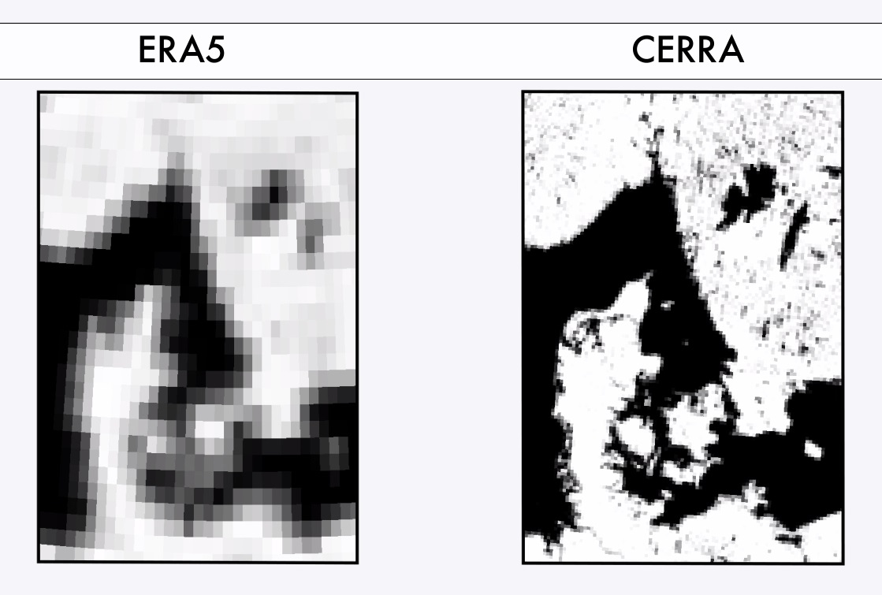
Land-Sea-mask
Higher resolution enables a more realistic representation of e.g. coastlines and lakes

Slide 8
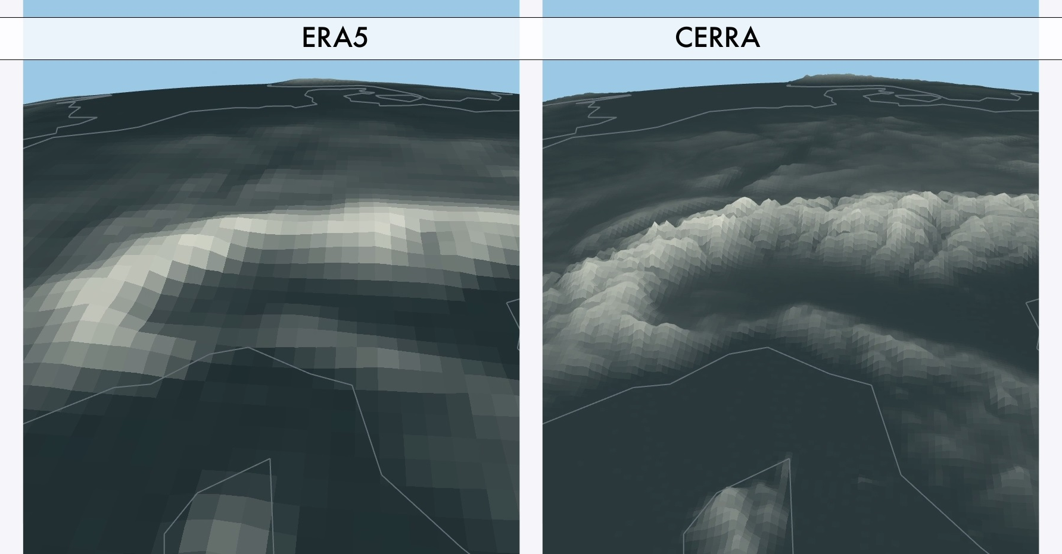
Topography

Slide 9
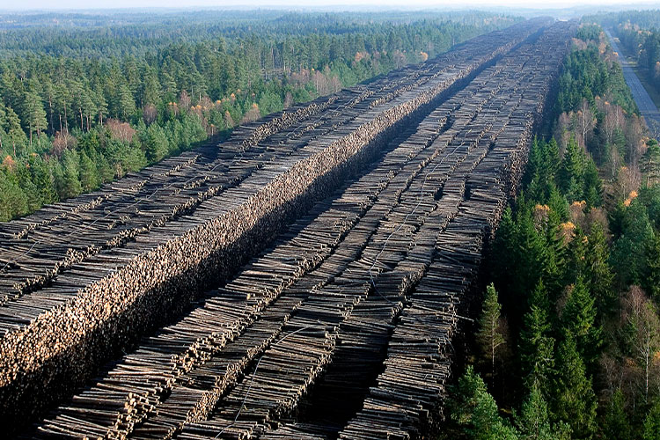
Demonstration: storm Gudrun, southern Sweden, January 2005
Some facts:
Most severe storm ever registered in Southern Sweden in terms of power outages and forest devastations
(75 million cubic meter of lumber)
Seven people died
Source: https://www.elinstallatoren.se/2020/02/sa-minns-vi-stormen-gudrun-det-var-fel-att-ge-sig-ut-och-jobba-i-den-blasten/

Slide 10
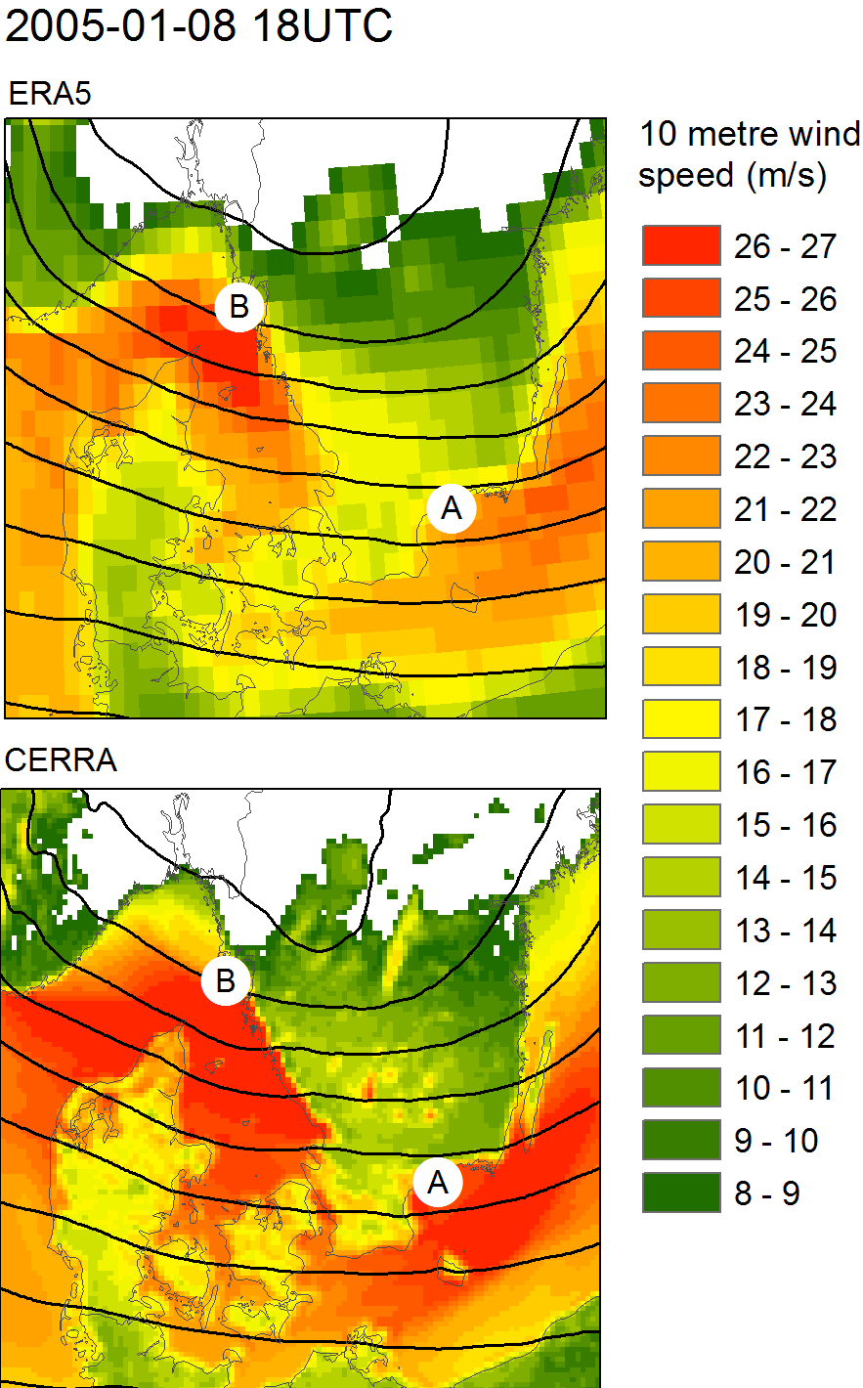
Demonstration: storm Gudrun, southern Sweden, January 2005
Demonstration: storm Gudrun, southern Sweden, January 2005
10m wind speed at the culmination of the storm at 18 UTC 08/01/2005
Generally higher wind speeds in CERRA compared to ERA5
More realistic features related to topography and land-sea mask, e.g.
  higher wind speed over lakes, e.g. lakes Vättern and Bolmen stick out in CERRA
  Lower and more realistic wind speed over the island Bornholm in CERRA. That is related to a higher surface roughness.

Slide 11
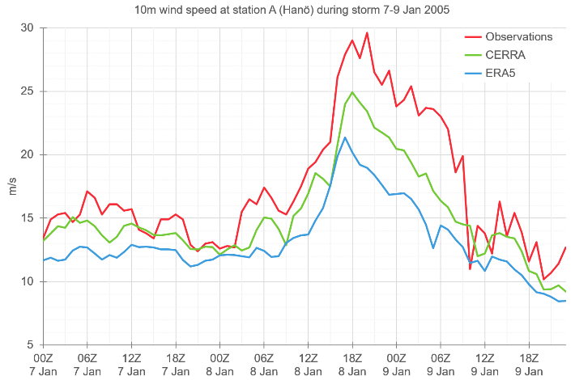
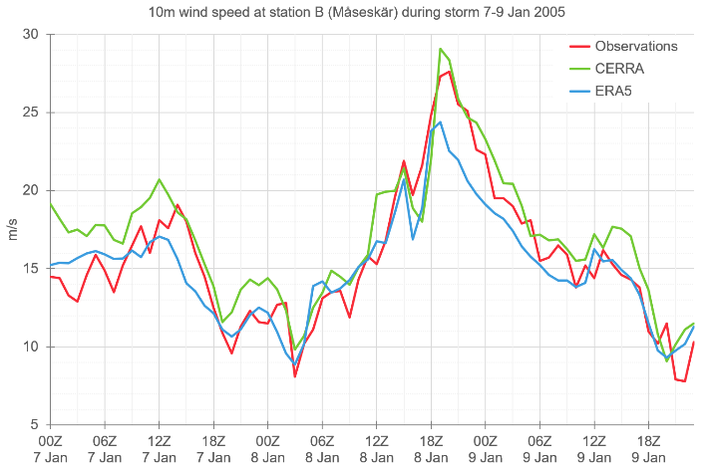
Demonstration: storm Gudrun, southern Sweden, January 2005
A
For many Swedish stations we see a better fit to observations in CERRA
Corresponding to previous figure usually too low wind speed in ERA5
B

Slide 12
Statistics for T2m and wind speed
Wind speed at 10m
 | Observations | ERA5 | UERRA | CERRA
Mean [m/s] | 6.01 | 5.95 | 6.14 | 6.18
Mean abs. error (MAE) |  | 0.84 | 0.59 | 0.60
RMSE |  | 1.95 | 1.89 | 1.74
Correlation |  | 0.85 | 0.85 | 0.88
Temperature at 2m
 | Observations | ERA5 | UERRA | CERRA
Mean [degC] | 6.97 | 6.98 | 6.97 | 6.88
Mean abs. error (MAE) |  | 0.14 | 0.15 | 0.15
RMSE |  | 1.42 | 1.46 | 1.12
Correlation |  | 0.982 | 0.982 | 0.989
Assessment is based on hourly data for a 1996 – 2018 at >30 Swedish coastal stations.
Notes:
EURO4M: 22km, 1989-2010??

Slide 13
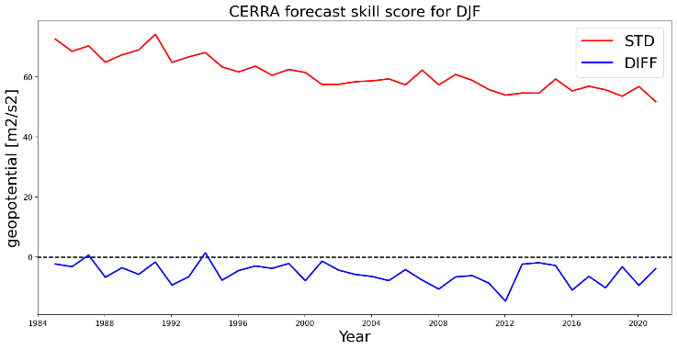
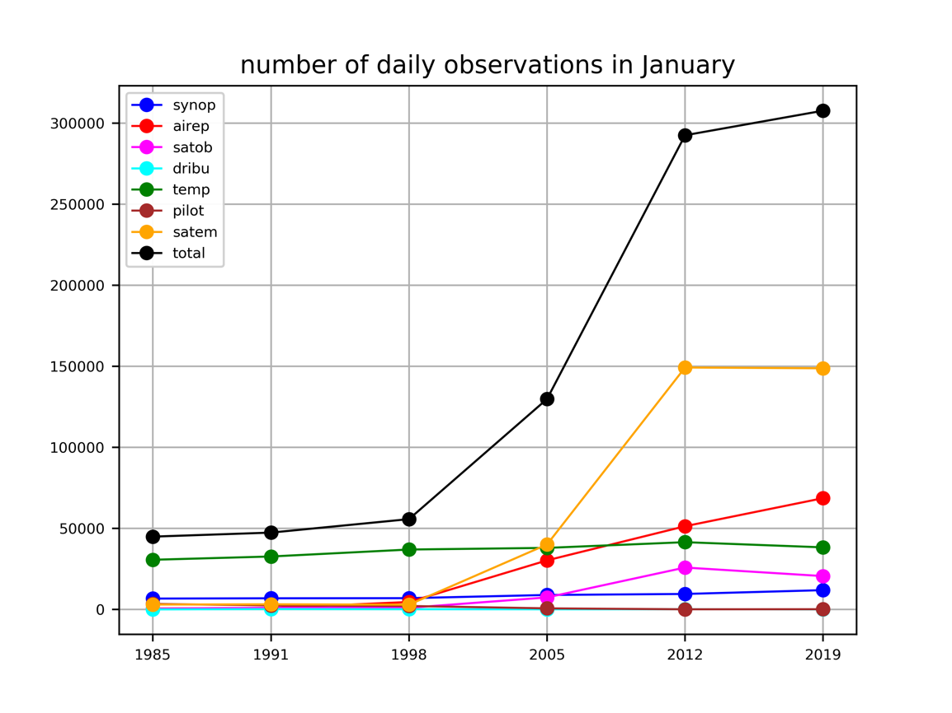
Homogeneity – Forecast skill
500 hPa GPH
Forecast skill (differences between fc30 and fc6):
Forecast skill effects accuracy of the first guess and has herewith consequences on the data quality
Increase of quality due to increasing numbers of observations over time
Yearly averages of the standard deviation and mean of the forecast difference fc30-fc06 during winter (DJF).
total
satellite
aircraft
radiosonde
Notes:
Figure 16. Yearly averages of the standard deviation and mean of the forecast difference fc30-fc06 for wind speed at 100 meters height for winter (left) and summer (right). 06 UTC and 18 UTC are the forecasts’ respective valid time. Note the different scales on the y axes. From UERRA data over the EURO domain.
Adam von Kraemer: Temporal consistency of the UERRA Regional Reanalysis: Investigating the Forecast Skill
T2m, wind speed at 100 meters, 500 hPa geopotential
Land points only
Comparison ERA40 vs. ERA-int
Influence from observing system after 1979
Difference between fc30 and fc6 (forecast skill)
Forecast skill effects accuracy of the first guess and has herewith consequences on the data quality
The data has lower quality in the beginning
Largest change of forecast skill in 1979

Slide 14
Summary
CERRA is produced as part of the C3S services
CERRA is the successor of UERRA-HARMONIE and comes with plenty of improvements
Quality of CERRA improves compared UERRA-HARMONIE and is adding value to the global reanalysis ERA5

Slide 15
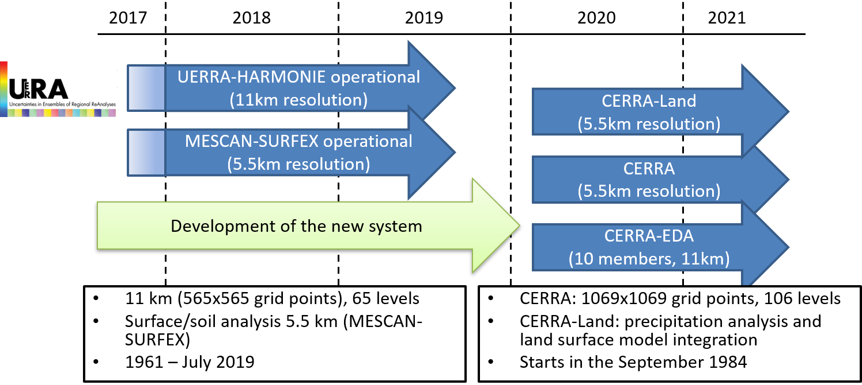
Outlook
2022
2023
2024
2025
Near real-time updates
Backwards extension, potential start 1940
Notes:
UERRA=Uncertainties in Ensembles of Regional ReAnalysis, a preoperational FP7 project, www.eurra.eu
EDA=Ensemble data assimilation
Note that the surface downscaling in the UERRA system is decoupled (offline) from the 3D product. In contrast to that the surface analysis will be included into the new system.

Slide 17
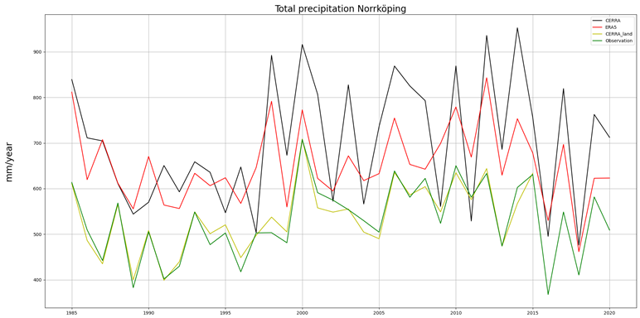
Demonstration CERRA-Land: 24h precipitation analysis
CERRA-Land clearly adds value to daily accumulated total precipitation
CERRA
ERA5
CERRA-Land
Observations

Slide 18
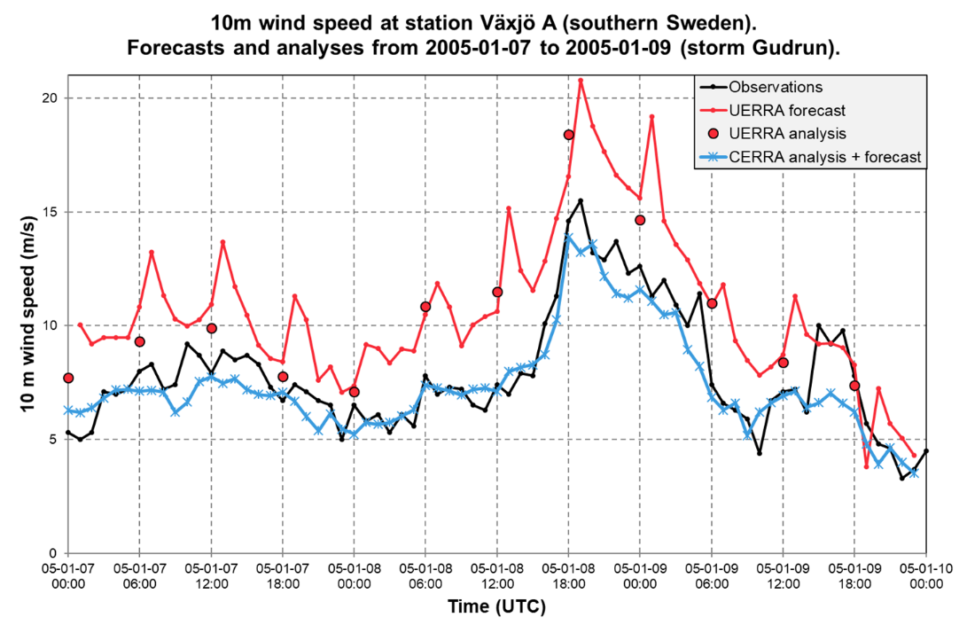
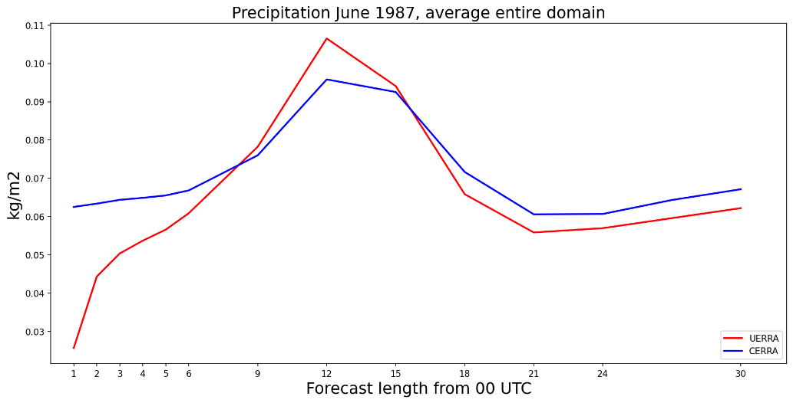
Lessons learnt from UERRA-HARMONIE
Total precipitation is underestimated during the first forecast hours in UERRA-HARMONIE and CERRA results look much better.
UERRA-HARMONIE wind speed suffers from a bad initialization of turbulent kinetic energy. The first forecast hours are effected. The issue was resolved for CERRA.

Slide 19
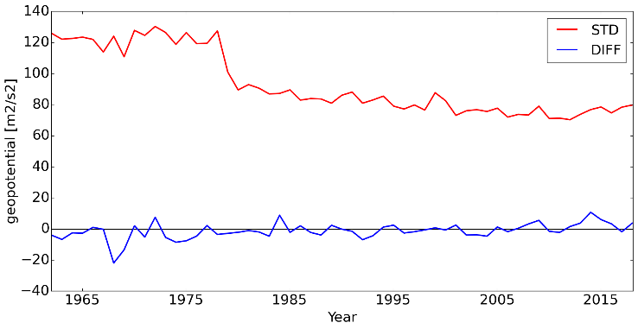
Homogeneity – Forecast skill
500 hPa GPH
UERRA-HARMONIE
Forecast skill (differences between fc30 and fc6):
Forecast skill effects accuracy of the first guess and has herewith consequences on the data quality
UERRA-HARMONIE, increase of quality due to
  switch to ERA-interim
  increasing numbers of observations over time
CERRA, increase of quality due to
  increasing numbers of observations over time
CERRA
Yearly averages of the standard deviation and mean of the forecast difference fc30-fc06 during winter (DJF).
Notes:
Figure 16. Yearly averages of the standard deviation and mean of the forecast difference fc30-fc06 for wind speed at 100 meters height for winter (left) and summer (right). 06 UTC and 18 UTC are the forecasts’ respective valid time. Note the different scales on the y axes. From UERRA data over the EURO domain.
Adam von Kraemer: Temporal consistency of the UERRA Regional Reanalysis: Investigating the Forecast Skill
T2m, wind speed at 100 meters, 500 hPa geopotential
Land points only
Comparison ERA40 vs. ERA-int
Influence from observing system after 1979
Difference between fc30 and fc6 (forecast skill)
Forecast skill effects accuracy of the first guess and has herewith consequences on the data quality
The data has lower quality in the beginning
Largest change of forecast skill in 1979

Slide 20
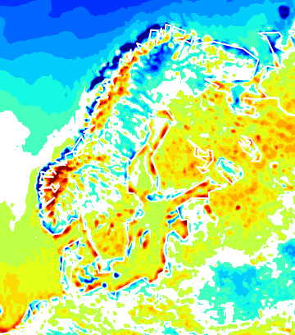

DJF windspeed in ERA5 and UERRA
Wind speed differences between ERA5 and UERRA
m/s
Differences mainly smaller than 1m/s
Most differences are related to topography and the coastline

Slide 21
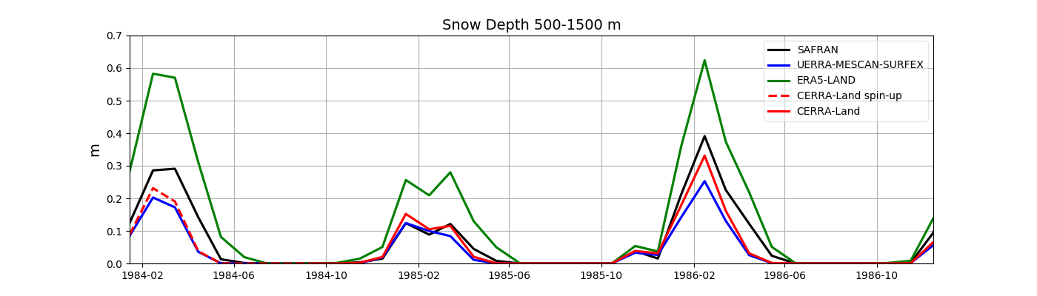
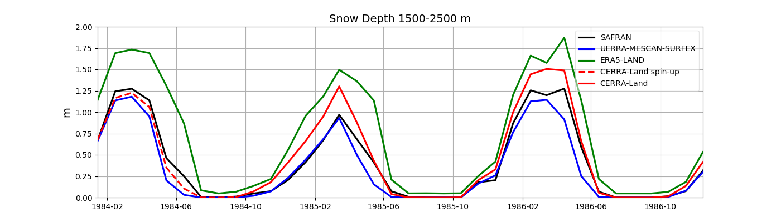
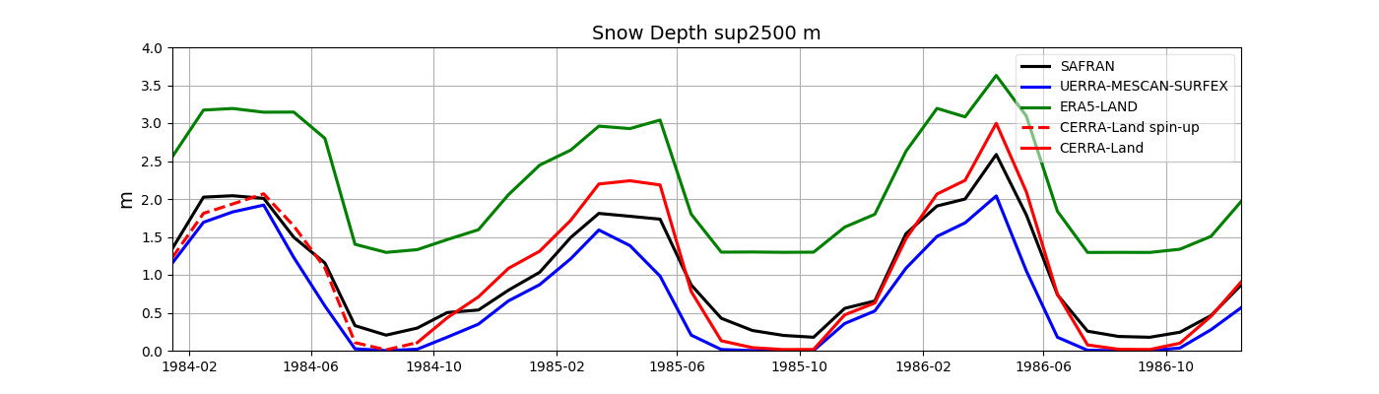
Demonstration CERRA-Land: snow depth in the Alpine region
SAFRAN data can be considered as a dataset close to the truth
The regional products CERRA-Land and MESCAN-SURFEX outperform ERA5-Land, which overestimates the snow depth

