Slide 1



Processes important for forecasting of
clouds over snow
Trees in mist over snow. Photo: Peter van de Lavoir
Martin Hagman^{1, 2}
Gunilla Svensson²
¹ Swedish Armed Forces
² Department of Meteorology, Stockholm University

Slide 2
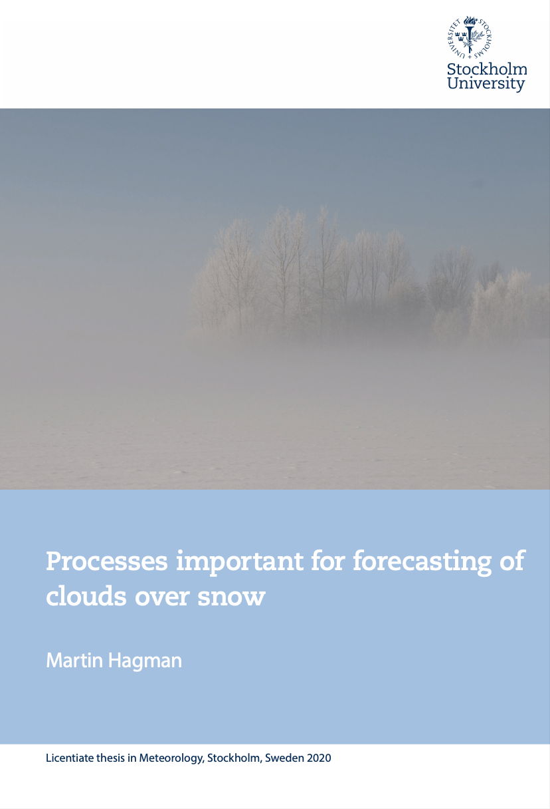

Slide 3
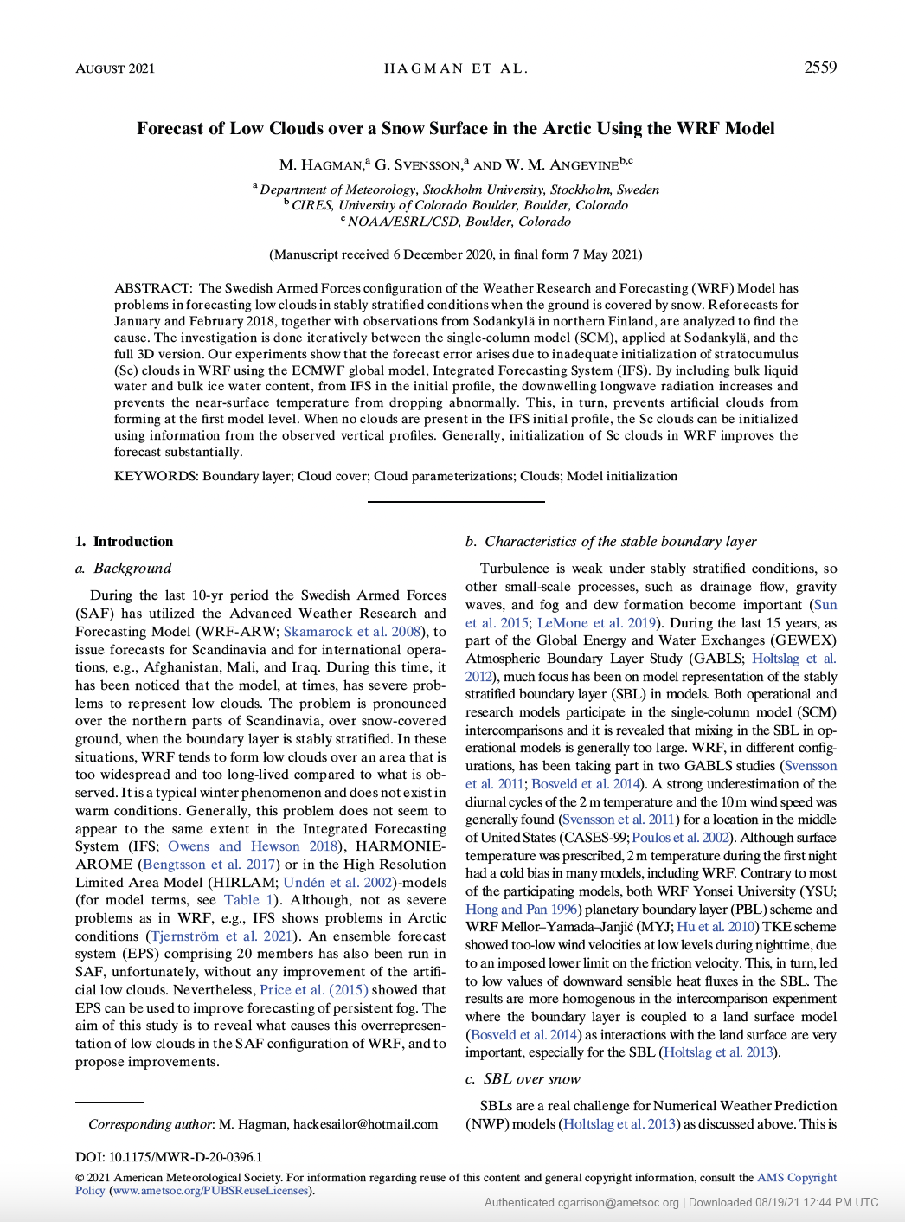

Slide 4

OUTLINE
Background
Stable Boundary Layers
Initialisation
Case study 1 – 2018-02-18
Case study 2 – 2018-02-27
Case from 2022-02-22
Conclusions
What causes the artificial
clouds?

Slide 5
OUTLINE
Background
Stable Boundary Layers
Initialisation
Case study 1 – 2018-02-18
Case study 2 – 2018-02-27
Case from 2022-02-22
Conclusions
What causes the artificial
clouds?

Slide 6
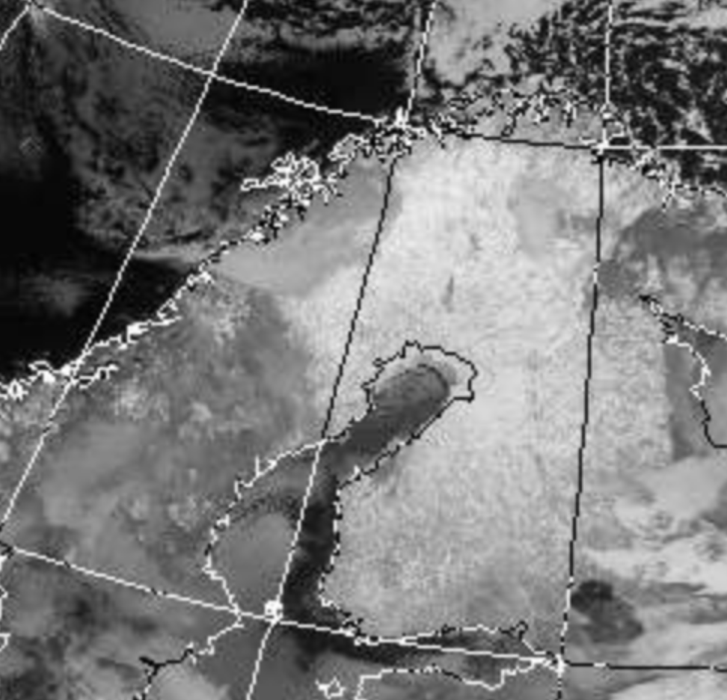
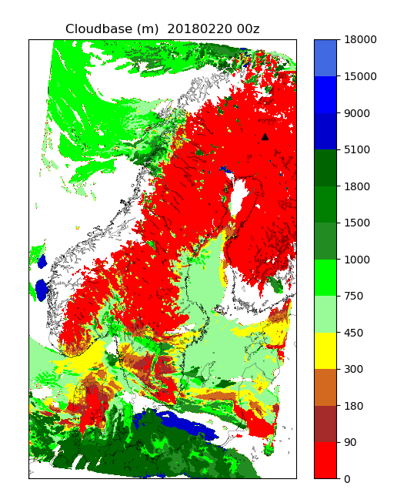
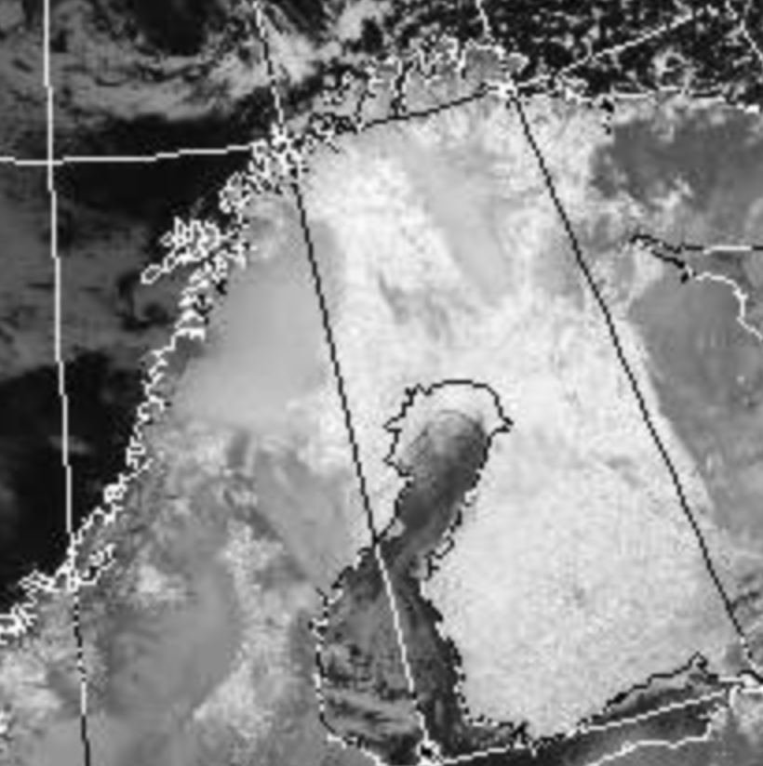
180219 1937z
6-hour forecast 2018021918z +06
CLOUD BASE
(m)
180220 0300z

Slide 7
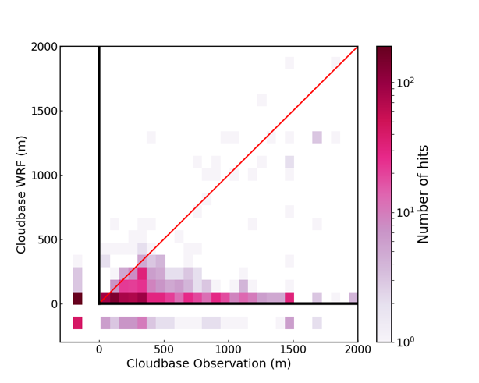
Cloud base WRF vs Observations for Sodankylä
24 hour consecutive simulations, January and February 2018

Slide 8

OBJECTIVE
Get rid of low artificial clouds

Slide 9

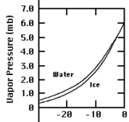
-25ºC < T < -5ºC
Saturation water vapor pressure
over water vs ice
Snow surface

Slide 10
OUTLINE
Background
Stable Boundary Layers
Initialisation
Case study 1 – 2018-02-18
Case study 2 – 2018-02-27
Case from 2022-02-22
Conclusions
What causes the artificial
clouds?

Slide 11
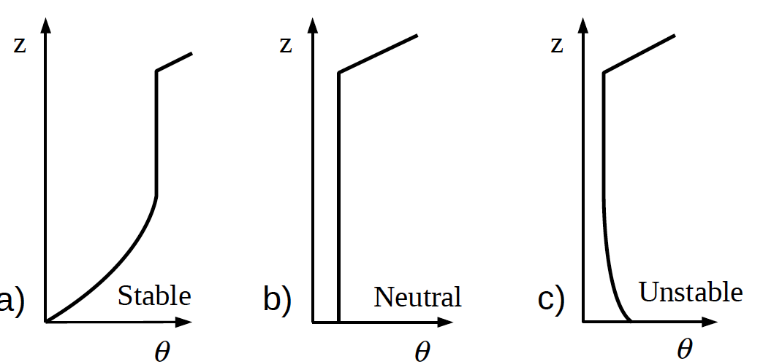
Boundary layer temperature profiles
Stable surface
conditions
Neutral surface
conditions
Unstable surface
conditions
Stable
Neutral
Stable
v
v
v

Slide 12
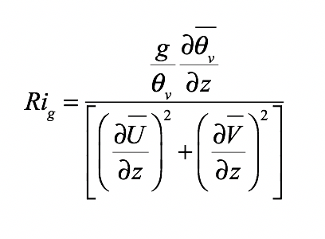
Turbulence in SBL
TKE-equation
+
+
+
or destruction.
(Buoyancy)
(Shear)

Slide 13
OUTLINE
Background
Stable Boundary Layers
Initialisation
Case study 1 – 2018-02-18
Case study 2 – 2018-02-27
Case from 2022-02-22
Conclusions
What causes the artificial
clouds?

Slide 14
PBL
PARAMETERIZATION
INTERPOLATION
INITIALISATION
RESOLUTION
CLOUD FRACTION
PARAMETERIZATION

Slide 15
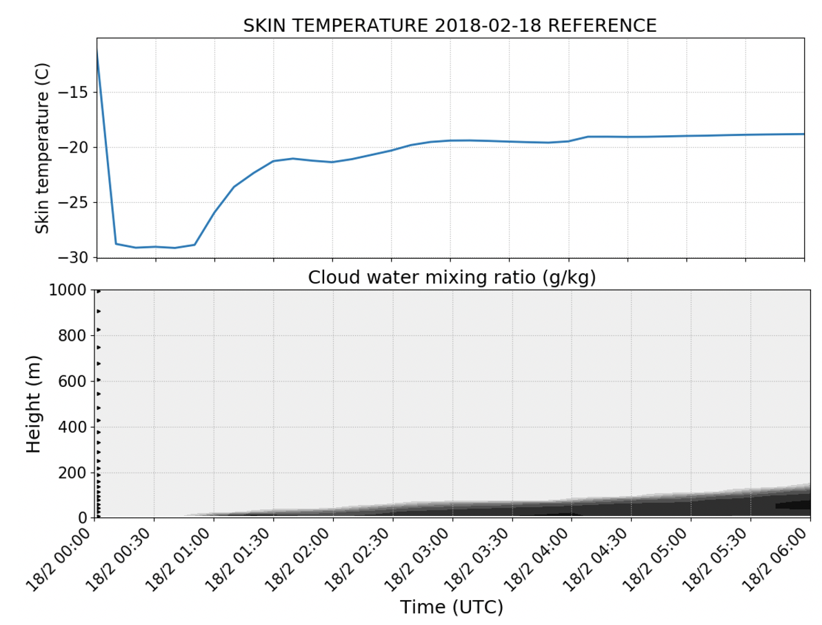
Temperature (How it should be…)
Modeled temperature

Slide 16


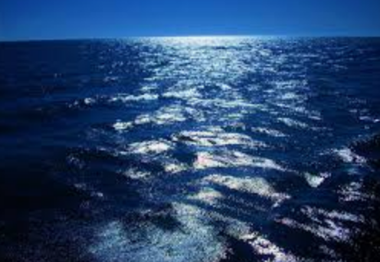
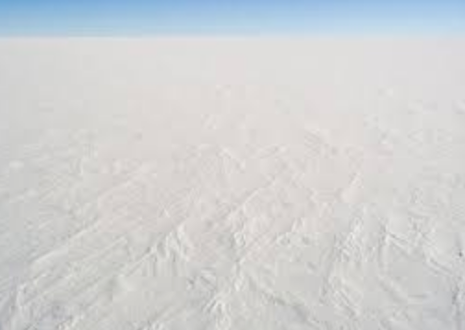
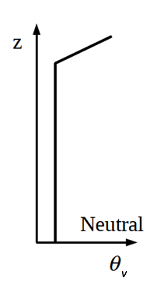
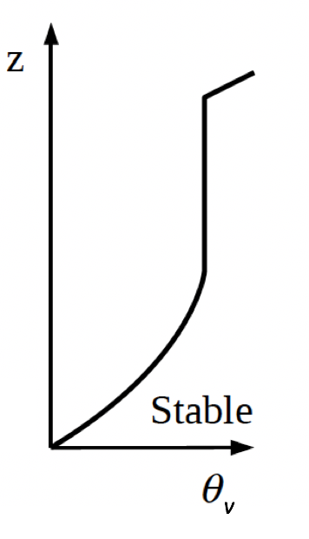
Tropic vs. Arctic
Stratocumulus
Warms surface
due to
downward LW
Cools Surface due
to reflection
Cloud top
Net LW ≈ 0
Net LW = +

Slide 17
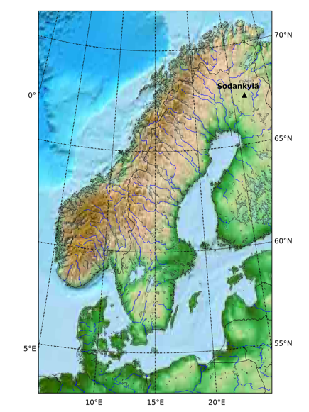
SAF DOMAIN
Non-hydrostatic
90 vertical levels
3 km horizontal resolution
Arakawa C-grid
ECMWF initial and boundary conditions
Initialised with specific humidity, not
cloud water, cloud ice or cloud fraction
No spin up for soil parameters.
Data assimilation
702
429

Slide 18
OUTLINE
Background
Stable Boundary Layers
Initialisation
Case study 1 – 2018-02-18
Case study 2 – 2018-02-27
Case from 2022-02-22
Conclusions
What causes the artificial
clouds?

Slide 19
Case study 1 - 180218

Slide 20
DIVIDE THE PROBLEM INTO 2 PARTS
CLOUDS IN ECMWF
NO CLOUDS IN ECMWF
How do we initialise them in WRF at time 0?

Slide 21
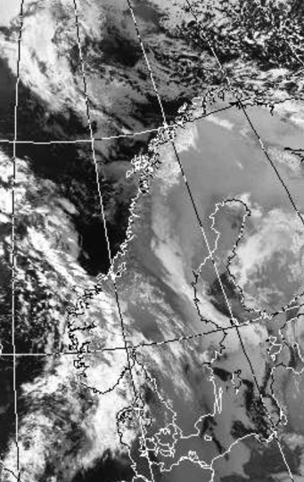
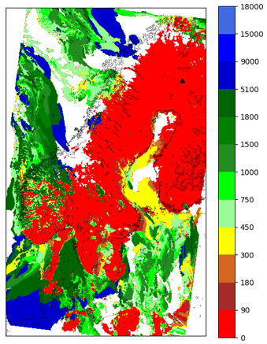
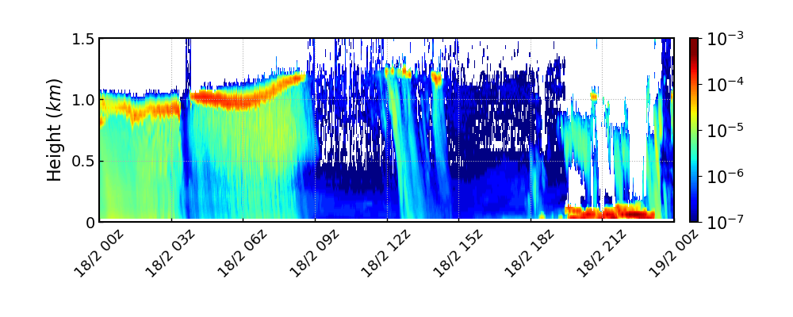
IR 180218 0323z
Cloud top
18021800z +06
Cloud base
(m)
LIDAR attenuated backscatter coeffecient
(m⁻¹sr⁻¹)

Slide 22

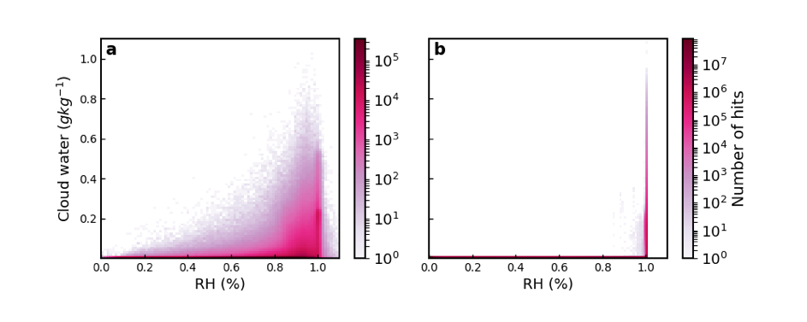
MODEL CLOUD CLIMATOLOGY IFS HRES vs WRF
All grid points below 2000 meters from whole domain
IFS HRES
WRF

Slide 23
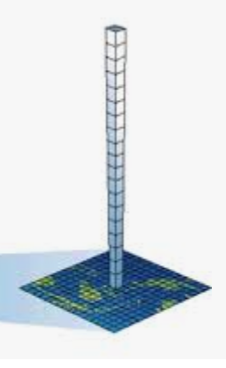
WRF SINGLE COLUMN
With a constant geostrophic wind and periodic boundary conditions.
(No advection, no subsidence).

Slide 24
INITIALISATION METHODS
Method 1 - Interpolation of cloud water from IFS
Method 2 - Interpolation of cloud water + temperature lowered to dewpoint
Method 3 - Interpolation of cloud water + water vapor mixing rato raised to
saturation water vapor mixing ratio.

Slide 25
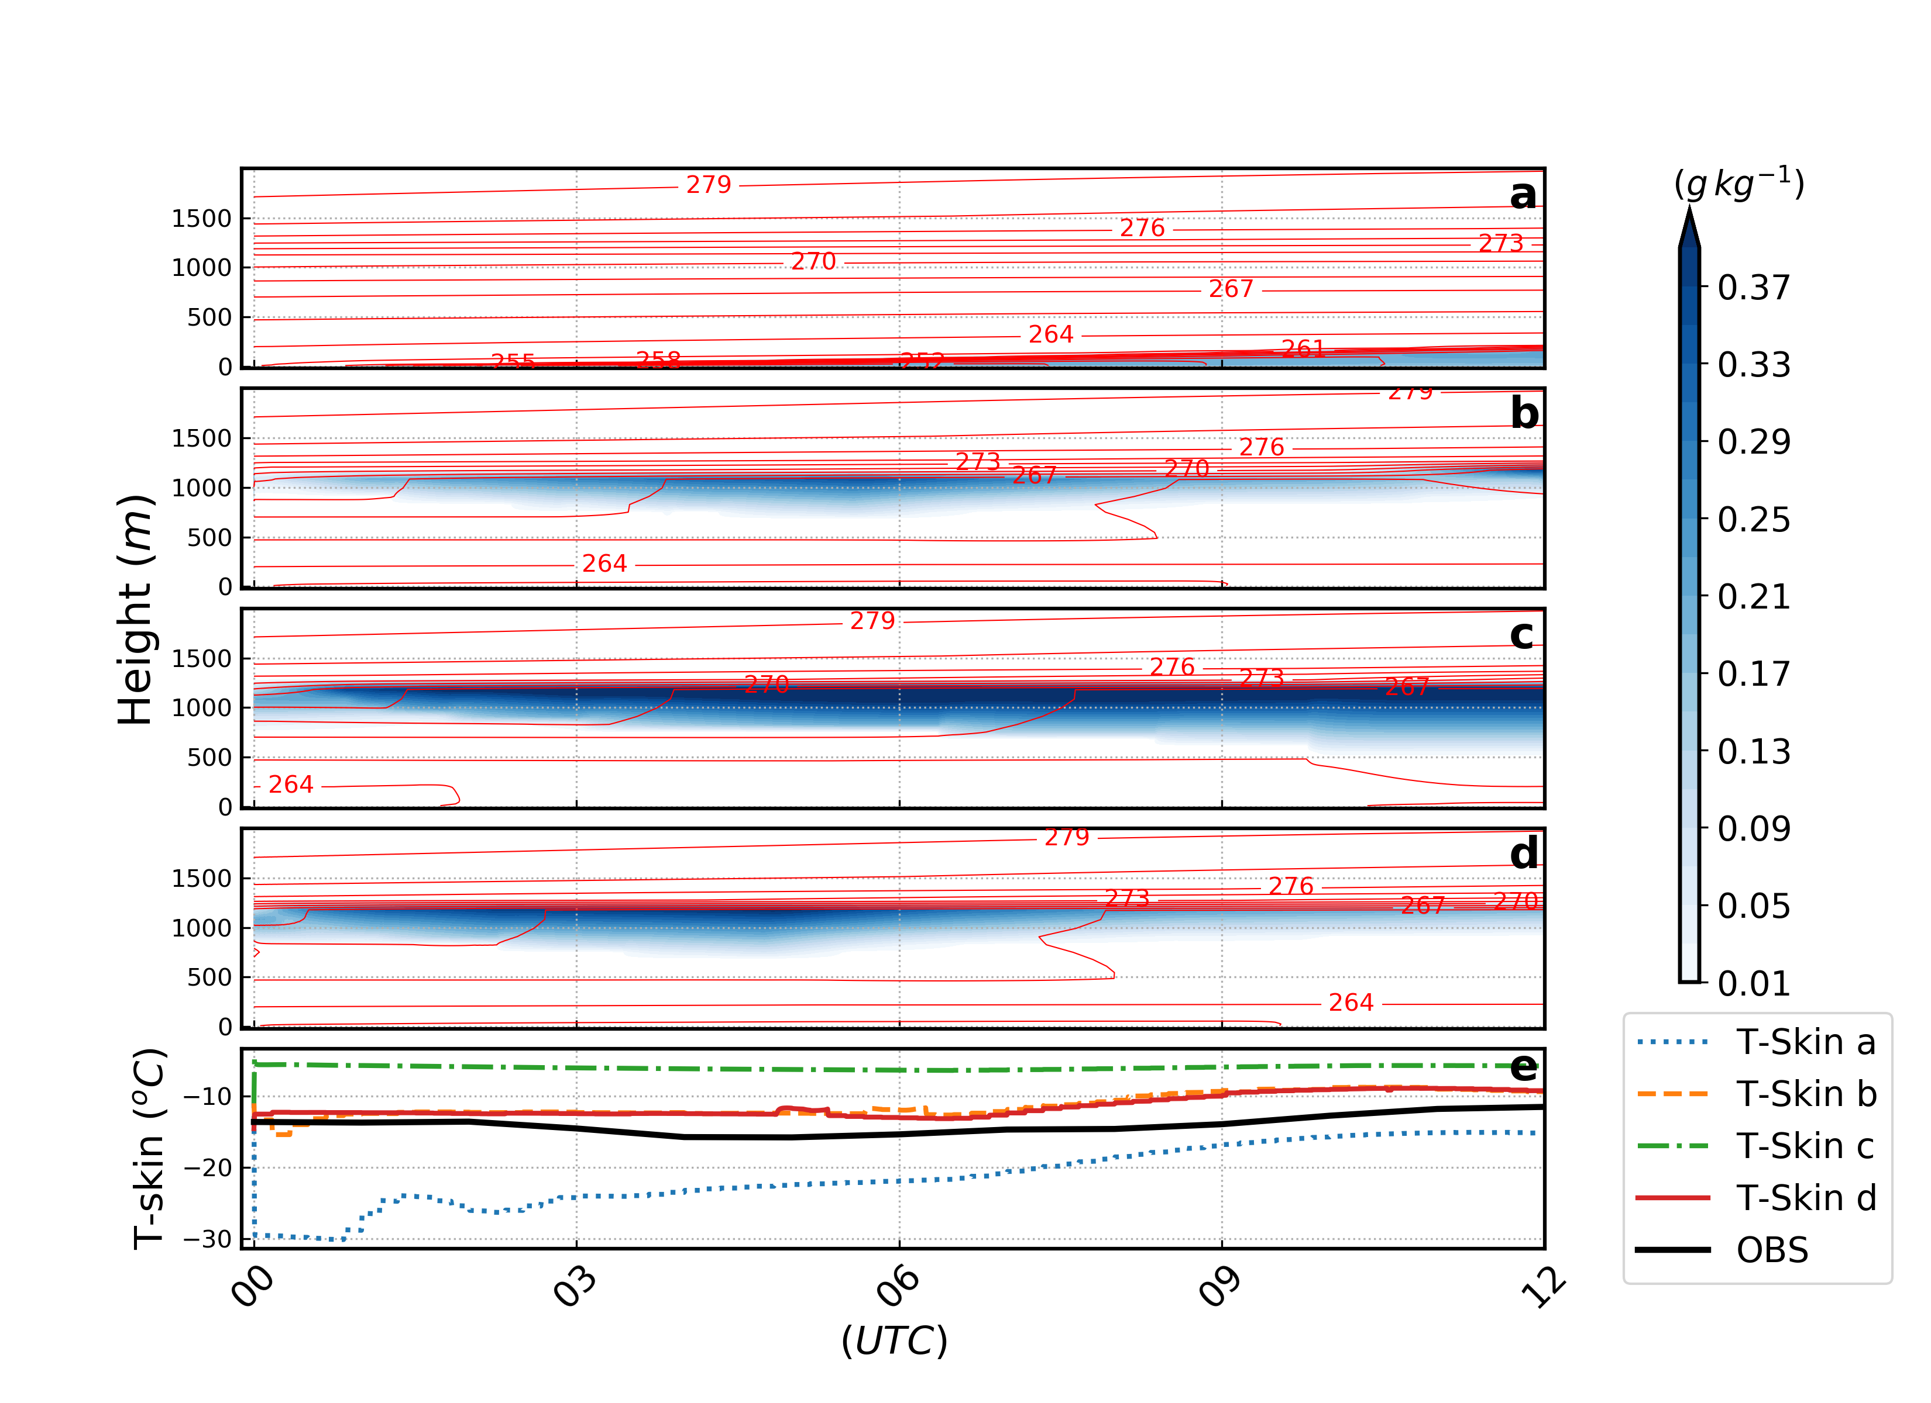
Just cloud water (CW)
CW+increased
mixing ratio
CW+lowered
temperature

Slide 26
WRF 3D

Slide 27
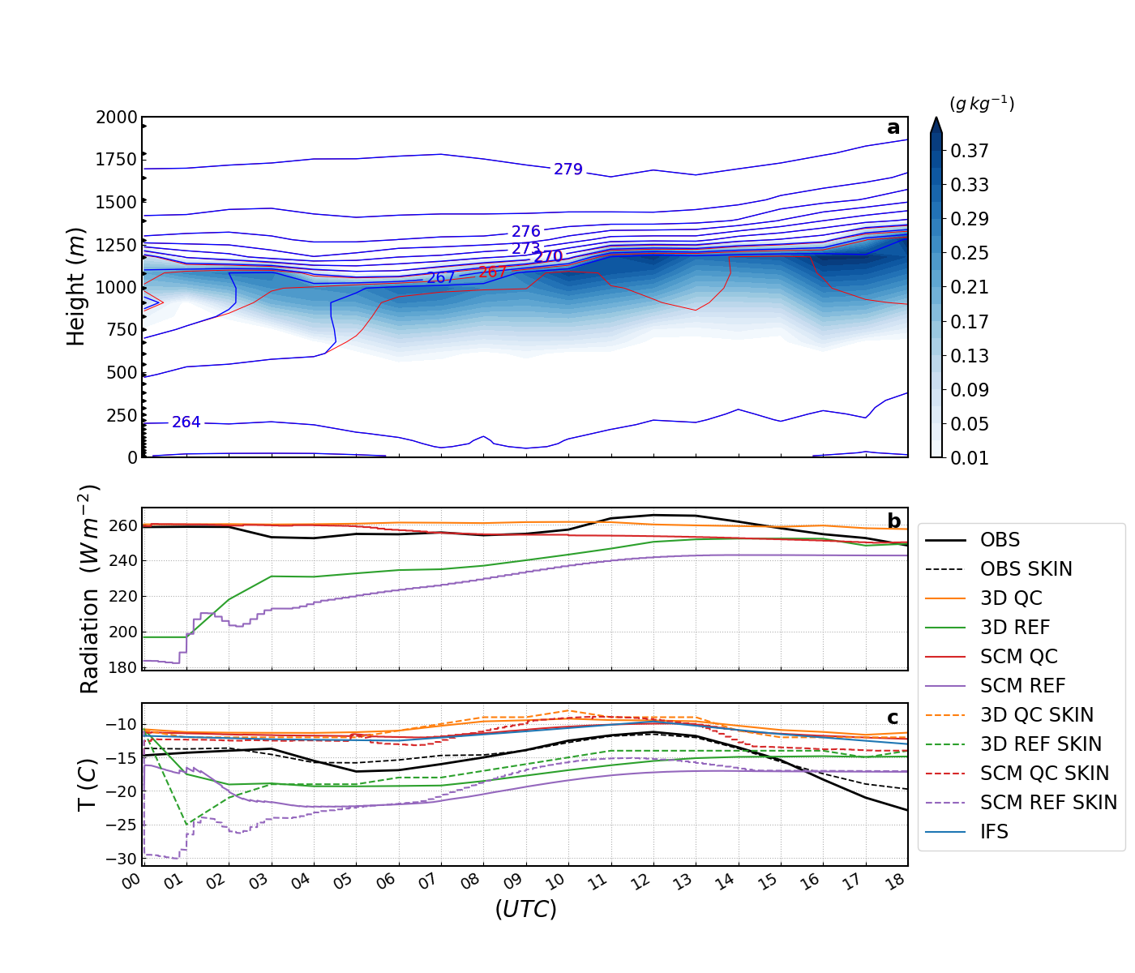
3D 18021800z Method B
Cloud water
θ
θ_{liquid}
Downwelling
long wave
T_{skin} (dashed)
T_{2m} (solid)

Slide 28
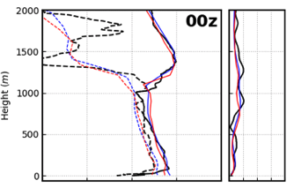
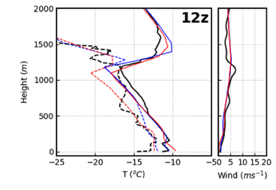


3D 18021800z Method 1

Slide 29
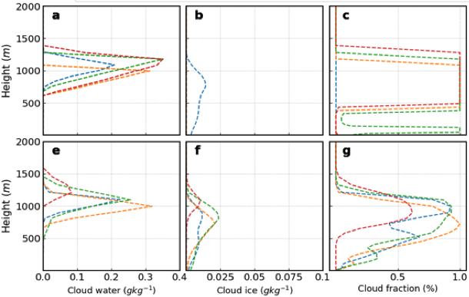
3D 180218 00z Method 1
WRF
IFS
Cloud water
Cloud ice
Cloud fraction

Slide 30

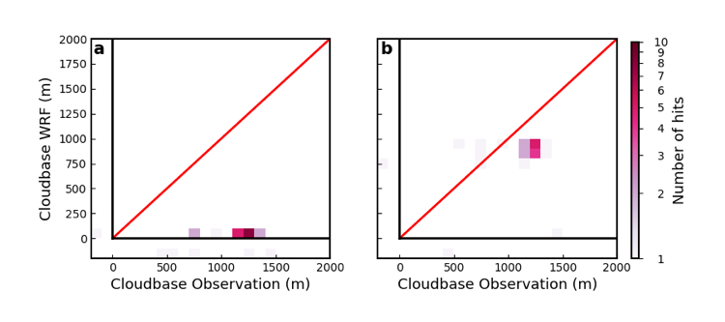
Observations vs WRF for Sodankylä every hour
For 24 hour simulations started at 180218 00z
No Initialisation
Initialisation

Slide 31
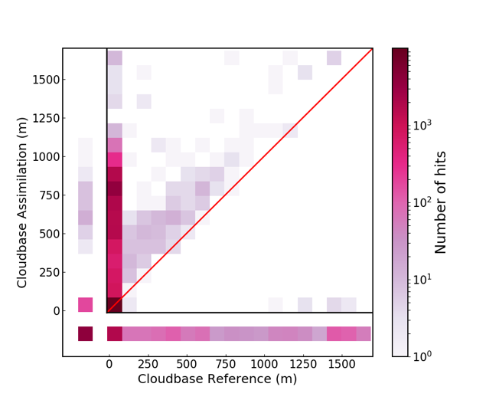
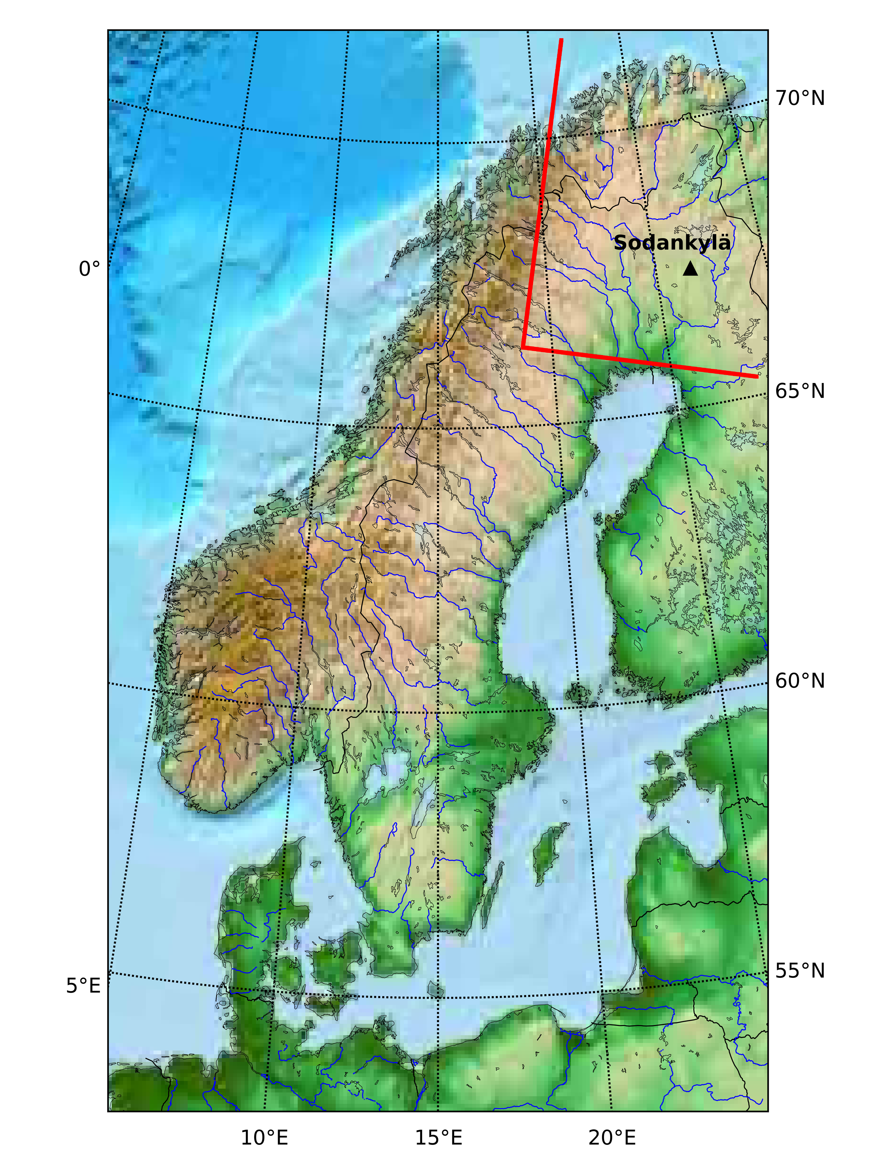
Reference vs initialisation (Method 2)
18021800z + 06

Slide 32
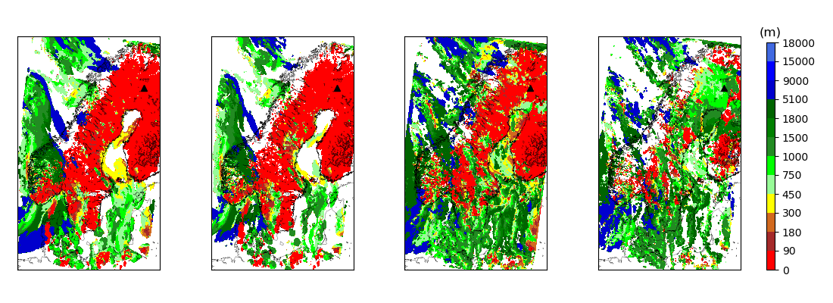
3D 180218 00z +03 (Method 2)
No initialisation
No initialisation
Initialisation
Initialisation
Ref + Xu and randall Ref + changed diagnostic CLW + Xu and Randall CLW + changed diagnostic

Slide 33

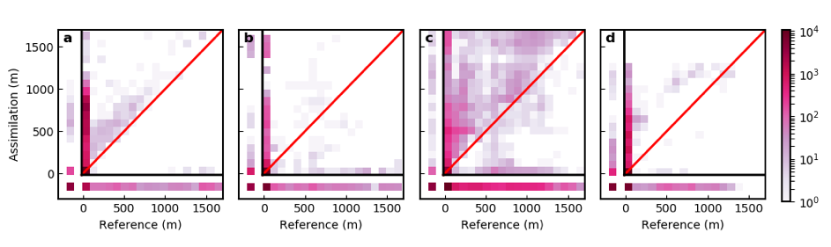
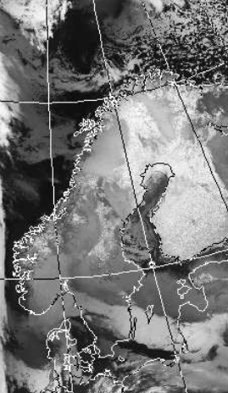
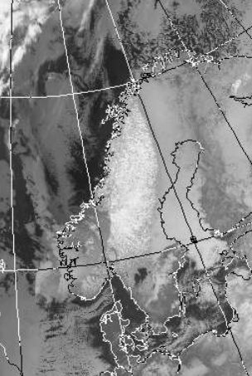
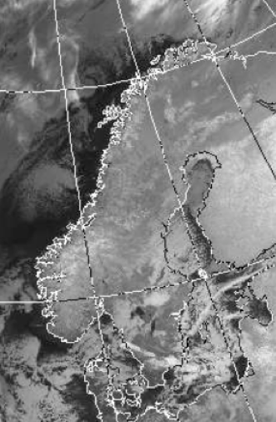
Reference vs initialisation(Method 2) cases
for four 6 hour simulations started 00z
18 Feb
20 Feb
26 Feb
27 Feb
Low artificial St clouds in IFS
from the beginning. No Sc.
IFS has Sc but small amounts
that dissolves and low St forms.
No clouds in IFS to transfer.

Slide 34
OUTLINE
Background
Stable Boundary Layers
Initialisation
Case study 1 – 2018-02-18
Case study 2 – 2018-02-27
Case from 2022-02-22
Conclusions
What causes the artificial
clouds?

Slide 35
Case study 2 - 180227

Slide 36
DIVIDE THE PROBLEM INTO 2 PARTS
CLOUDS IN ECMWF
NO CLOUDS IN ECMWF
How do we initialise them in WRF at time 0?

Slide 37
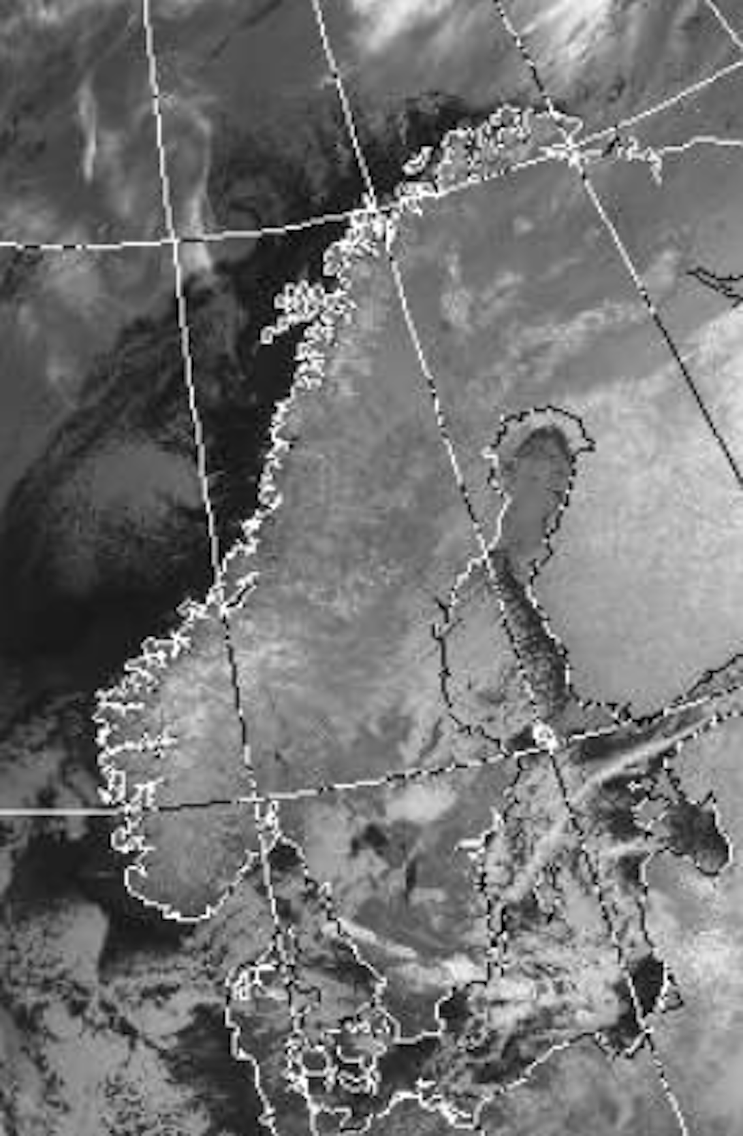
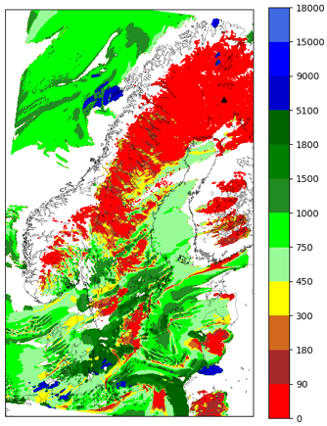
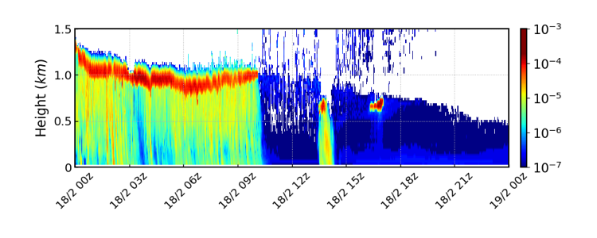
IR 180227 0332z
Cloud top
18022700Z +06z
Cloud base
(m)
LIDAR attenuated backscatter coeffecient

Slide 38
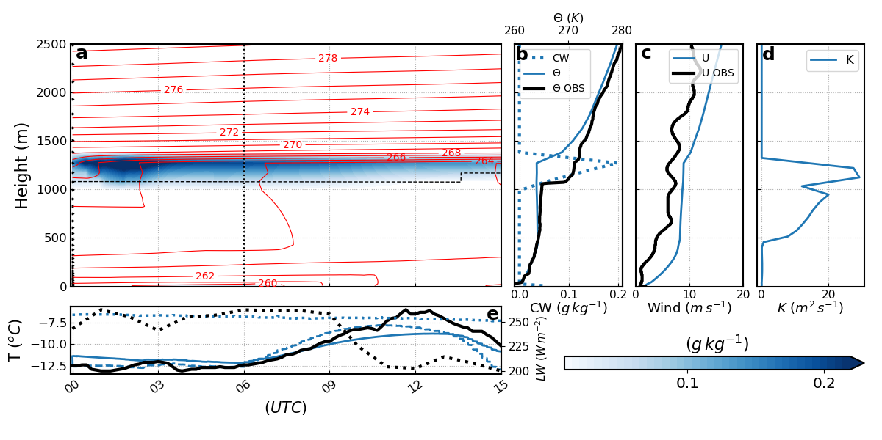
SCM
15 hour simulation started at 180227 00z
Dotted: LW
Solid: 2m-temperature
Dashed: Skin temperature
Black: OBS
Blue: WRF

Slide 39
WRF 3D

Slide 40

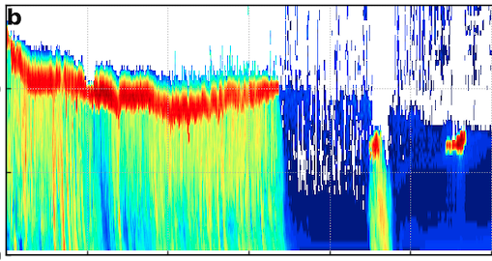
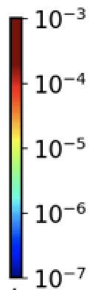
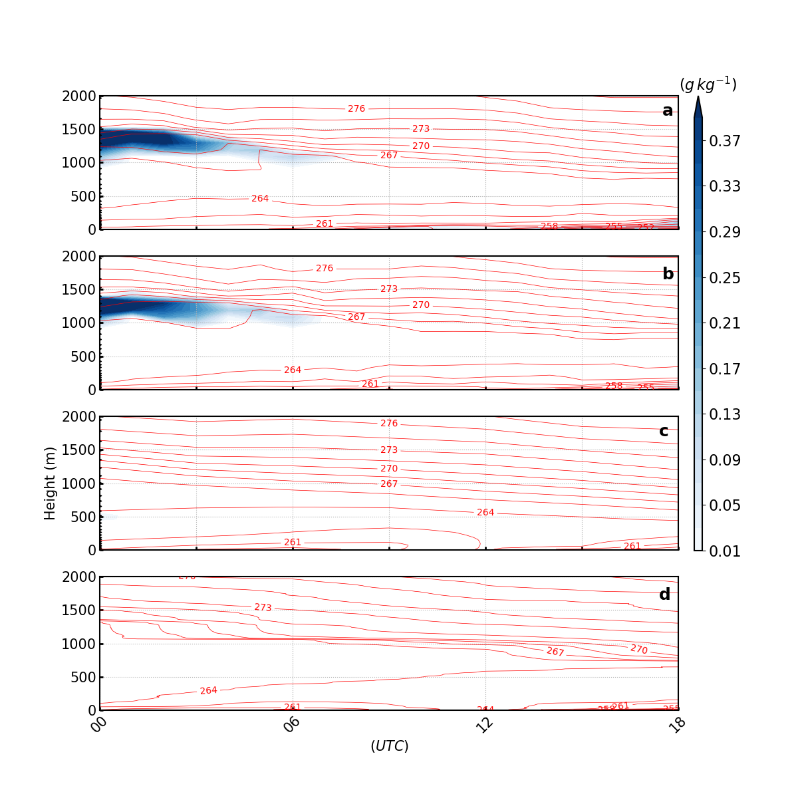
3D 18 hour simulations for Sodankylä started at 180227 00z
Observations
(LIDAR)
WRF with IFS
initial temperature
WRF with initialised
surface inversion.
IFS HRES
Observations
(Radio soundings)

Slide 41
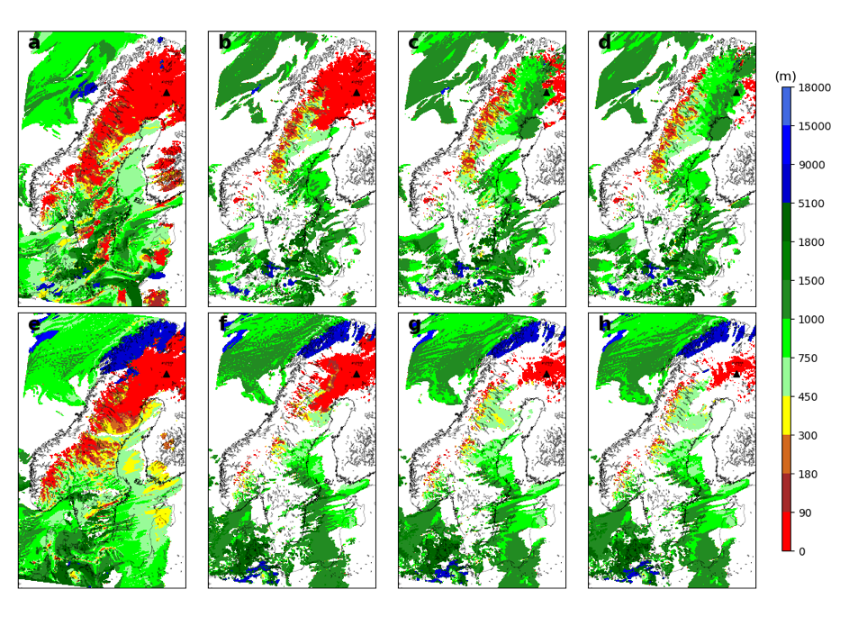
15 hour simulation started at 180227 00z
3 hour forecast
15 hour forecast
Reference +
Xu- and Randall
Reference +
changed diagnostic
Initialised clouds
from sounding +
changed diagnostic
Initialised clouds
from sounding +
surface inversion
from sounding +
changed diagnostic

Slide 42
OUTLINE
Background
Stable Boundary Layers
Initialisation
Case study 1 – 2018-02-18
Case study 2 – 2018-02-27
Case from 2022-02-22
Conclusions
What causes the artificial
clouds?

Slide 43
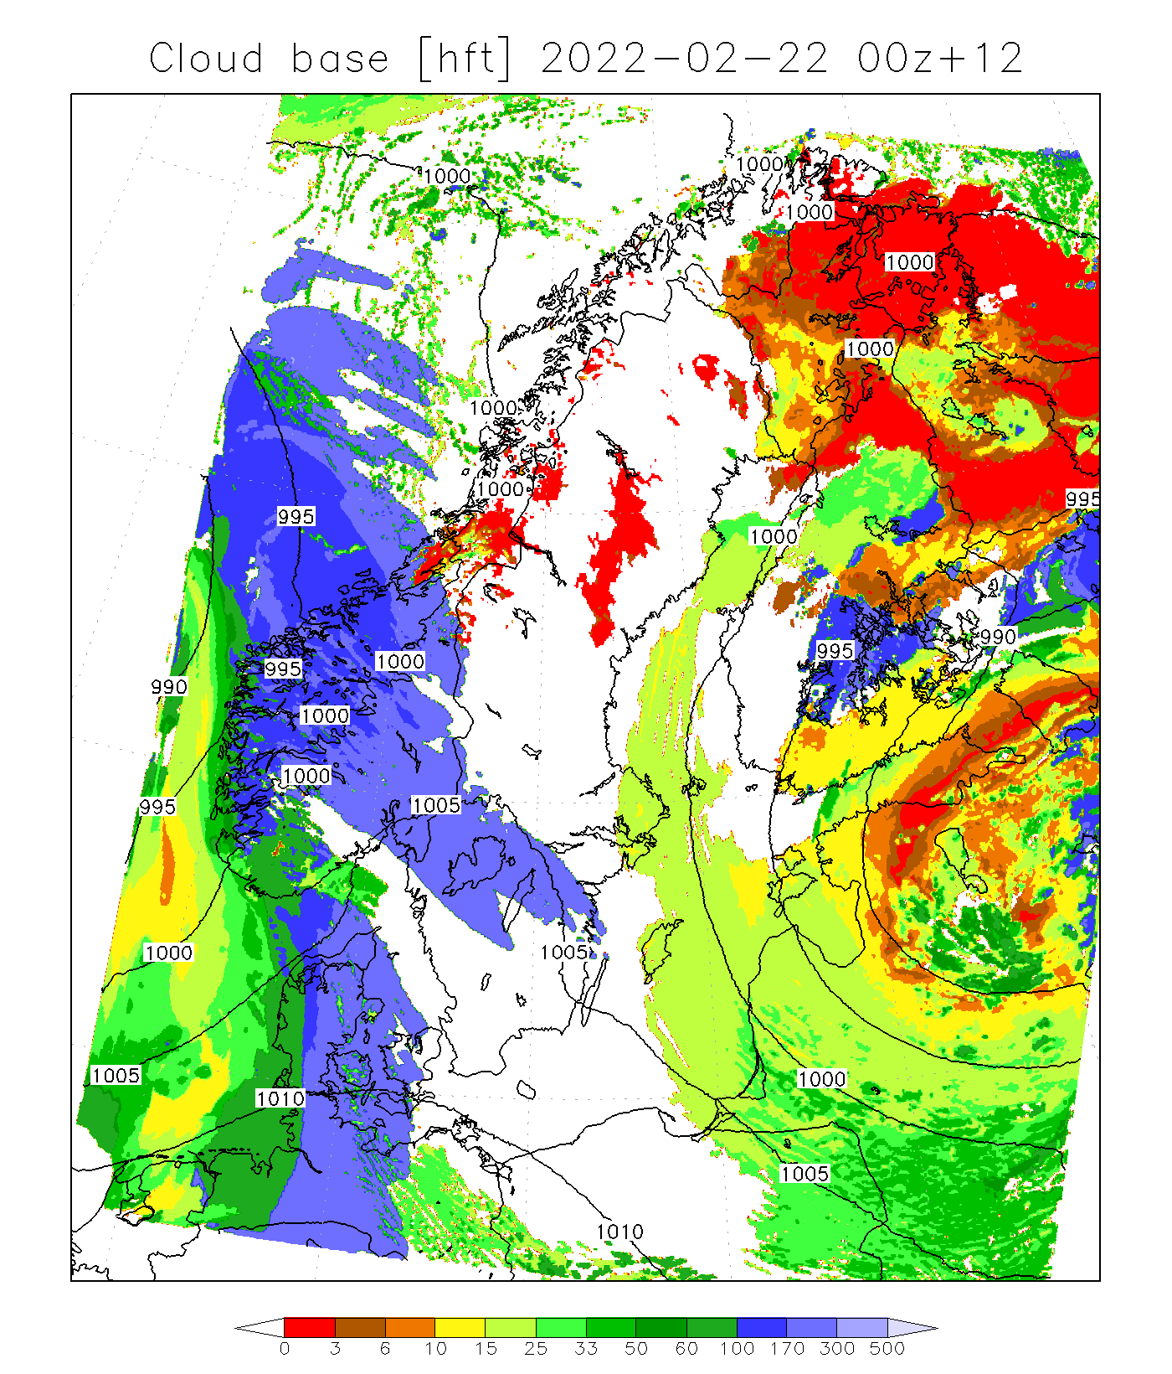
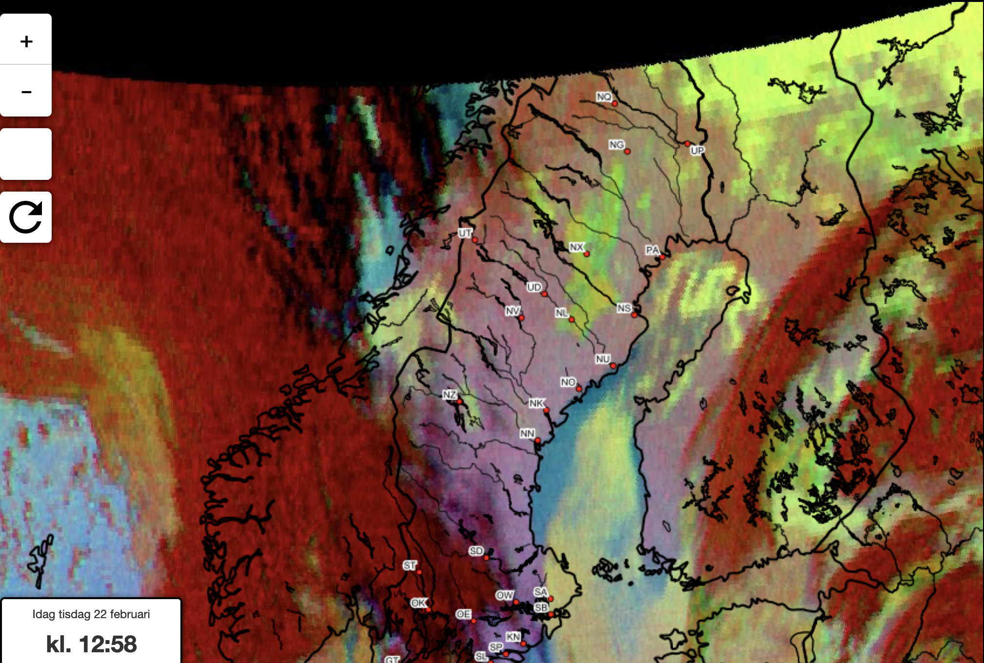
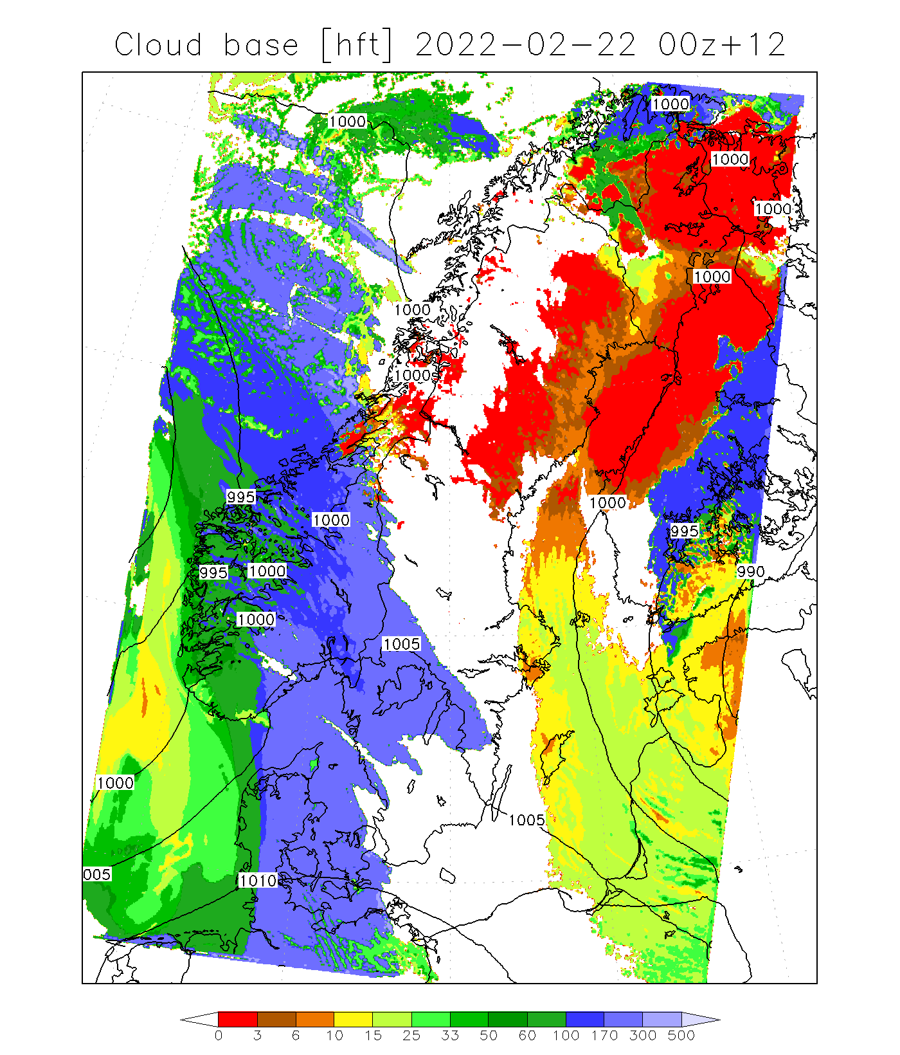
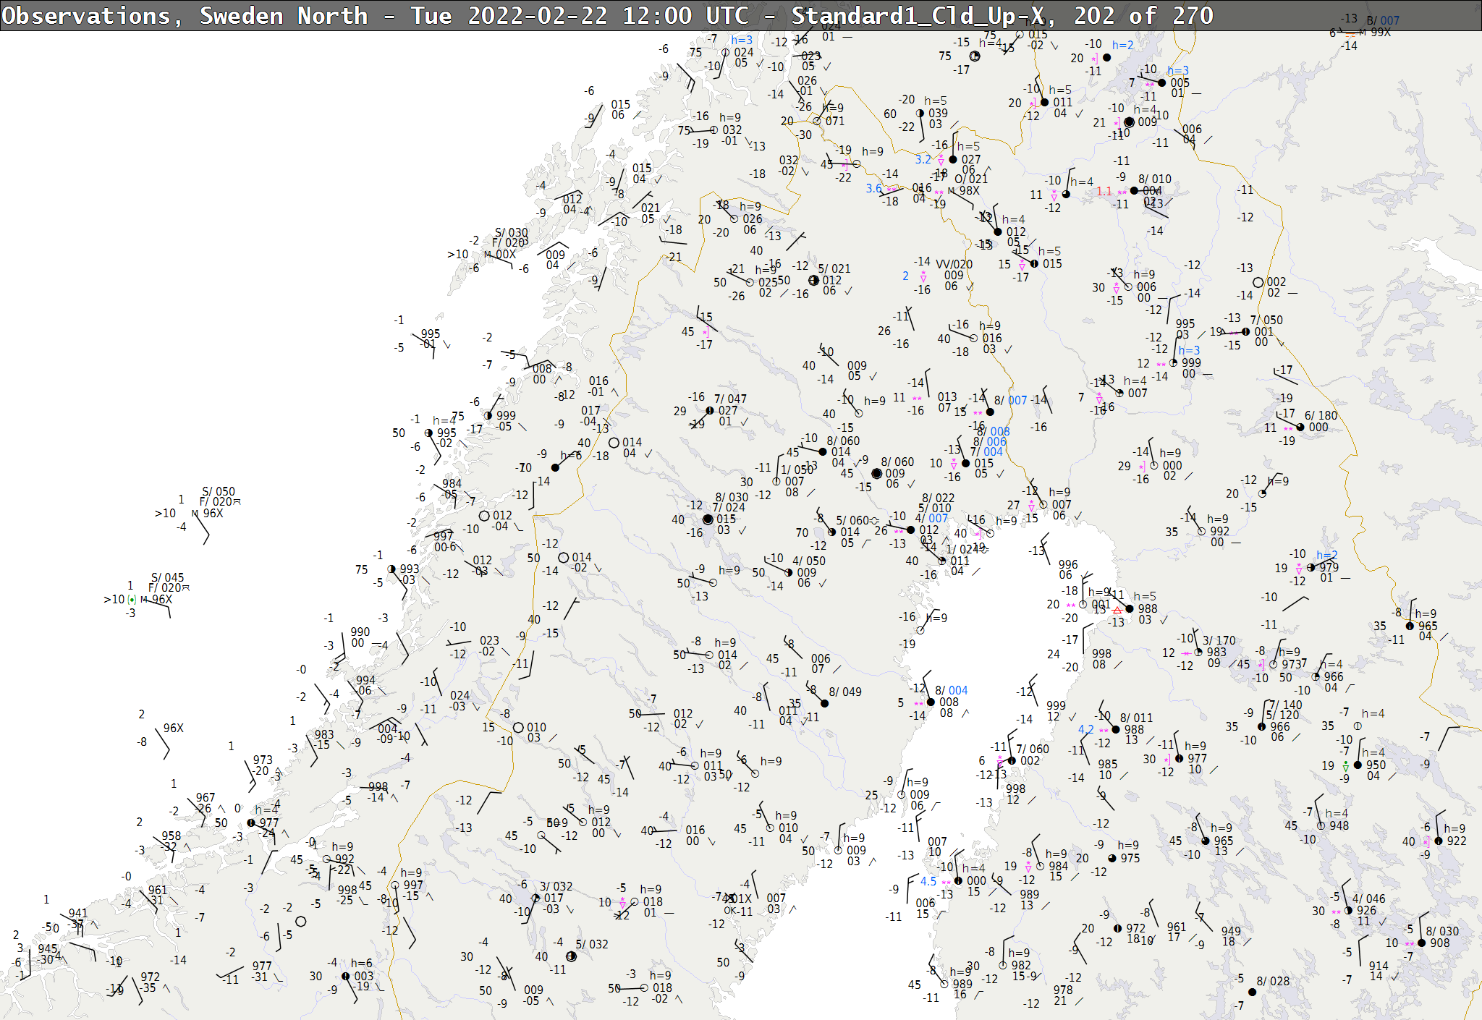
WRF versions vs REALITY 2022-02-22
WRF
Martin
WRF
Operational

Slide 44
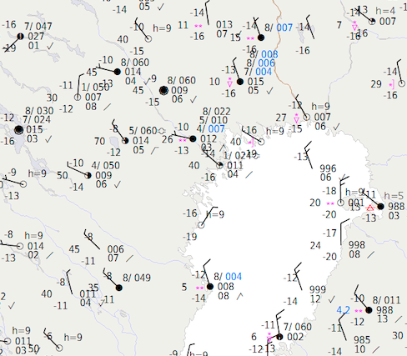

Slide 45
WRF versions vs REALITY 2022-02-22
WRF
Martin
WRF
Operational

Slide 46
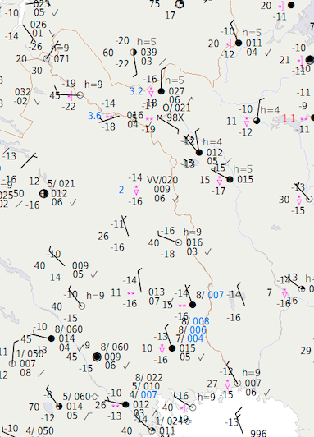

Slide 47
WRF versions vs REALITY 2022-02-22
WRF
Martin
WRF
Operational

Slide 48
OUTLINE
Background
Stable Boundary Layers
Initialisation
Case study 1 – 2018-02-18
Case study 2 – 2018-02-27
Case from 2022-02-22
Conclusions
What causes the artificial
clouds?

Slide 49


MAIN CONCLUSIONS
Shortcomings are mainly due to poor initialisation of Stratocumulus clouds. To small amounts of downwelling long wave radiation lead to abnormal drops in skin temperature.
Difficulties for WRF to keep the clouds are explained by the difference in the thermodynamic environment that support clouds in the two models. IFS cloud parameterization scheme produces cloud water and cloud ice for a wide range of RH, while RH in WRF needs to be almost 100% for clouds to exist.
By initalising cloud water and cloud ice from IFS HRES and from soundings we increased the downwelling long wave radiation at the surface. This prevents skin temperature to drop and prevents low clouds to form.
In the 3D model, the artificial cloud formation decreased as long as 24h into the forecast, when the observed temperature profile below 350 m in Sodankylä was initialised at every grid point, highlighting the importance of resolving a surface inversion in the initial fields.
Xu and Randall cloud fraction parameterization scheme exaggerates cloud amounts in Arctic conditions. It is better to change this to a simple parameterization only dependable on certain cloud water amounts.

Slide 50

Thanks for listening!

Slide 51


OUTLOOK
This thesis has uncovered some of the shortcomings in the treatment of low clouds in the forecast
process of Swedish Armed Forces set up of WRFV3.9.1.1. Some of the gains can be incorporated
immediately in the forecasting process.
1. Cloud water and cloud ice from IFS HRES can be added to the WRF initial fields.
2. An assimilation process can be imposed that is run back and forth until cloud water and cloud ice
exist at the same levels as in the host model from the very first time step instead of abruptly change
the temperature and humidity profiles.
3. Incorporate cloud water observations from LIDARs in the assimilation process.
4. Replace the Xu and Randall cloud fraction parameterization scheme with one that just depends on
certain amounts of hydrometeors.
5. Launch a WRF SCM forecast model at every air base initialised with clouds from soundings and or
LIDARs.
Forthcoming research comprises tests both in the SCM, as well in the full 3D version.
1. Include large-scale forcing, e.g. subsidence and advection, in the SCM version to resemble the
cases, studied here, better.
2. Conduct deeper studies of the interaction between the land surface and the boundary layer.
Is it possible to increase mixing in very stable situations and prevent the temperature gradient
to be too sharp near ground? How does the model respond to a multi-layer snowpack when the
initialisation of Sc clouds is done correctly? It has been seen that the model managed to keep the first
model free from cloud water and cloud ice in situations with clear skies and very low temperatures.
What distinguishes these profiles from the ones where the model fails?

